Slide 1


Python
Presented by
Srivalli Oguri

Slide 2
Basics
1. Introduction to scripts
7. Strings
13. Packages
2. Introduction to python
8. List
14. RegEx
3. Variables
9. Tuple
15. Miscellaneous
4. Operators
10. Set
5. Control structures
11. Dictionary
6. Functions
12. Errors

Slide 3
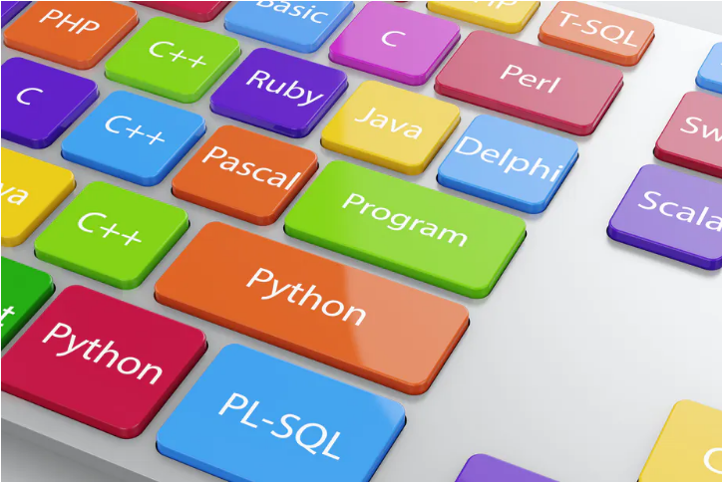
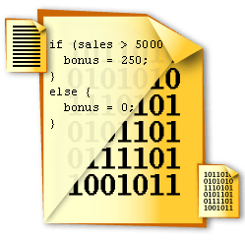
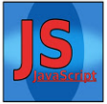
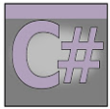


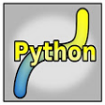
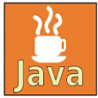
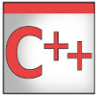
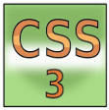

Computer languages - broad classification
Programming
Scripting
Markup
Source file
XML
Executable file

Slide 4


1. Introduction to Script
Contents
Differences between Programming and Scripting
Applications of Programming Languages
Applications of Scripting Languages
Application of Python - Real world example
Server side Vs Client side scripting

Slide 5
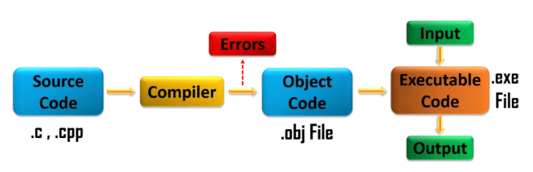

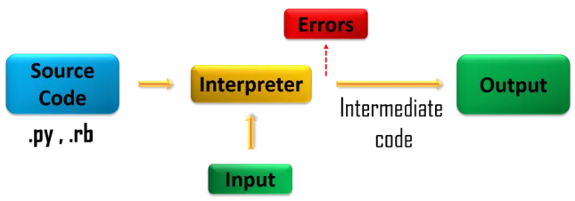
Programming Vs Scripting
Execution
Compiler
Interpreter
Compilation
Complete code
Line by Line
Interpretation
Run independently
Run inside another program
File type
Creates a file to be executed
Does not create any file
Speed
Fast
Slow
Development
Longer time
Less time
Platform Dependent
Yes
No

Slide 6
Applications of Programming Languages
C
Embedded System Applications
C is used in developing software for Operating systems, developement of new languages, computation platforms like Matlab. Embedded systems applications include speed checker on the highway, controlling of traffic lights, controlling of street lights, tracking the vehicle, artificial intelligence, home automation, and auto intensity control.
C++
Gaming Applications
C++ is used in designing compilers, developing software for operating systems, GUI based gaming applications, advanced computations and graphics, designing web browsers and also database like MySql. It is also used in the softwares for enterprise applications likebanking, in Medical applications like MRI machines, engineering applications like CAD/CAM systems etc
Java / .Net
Enterprise Level Applications
Java is widely used in Desktop GUI Applications like Acrobat Reader, Media Player, Antiviruses, etc.
Mobile applications like Photo and video gallery apps, Simple Calendar, QRReader, Google Earth etc.
Enterprise applications like Naukri, Google, Flipkart, Uber, Pinterest, eBay, etc use Java.
Web based applications like irctc.co.in, online forms, shopping carts, Gmail, Google Sheets, etc.
Java is also used in Big Data applications, Distributed applications, Cloud based applications, Web server and
Application servers like Apache Tomcat, Apache HTTP server, WebLogic, GlassFish, etc
It is used in software tools are Eclipse, IntelliJ Idea, and NetBeans IDE and other Gaming applications

Slide 7
Applications of Python
Python
Data Processing
1. Web Development
2. Game Development
3. Machine Learning and Artificial Intelligence
4. Data Science and Data Visualization
5. Desktop GUI
6. Web Scraping Applications
7. Business Applications
8. Audio and Video Applications
9. CAD Applications
10. Embedded Applications

Slide 8
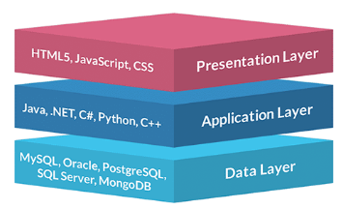
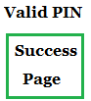
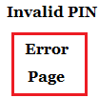
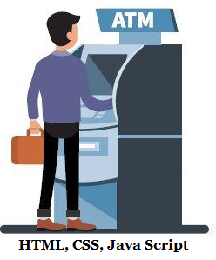
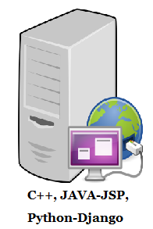
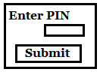
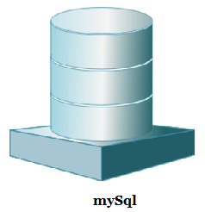
Python Application - Real World Example
Client
Server
Database
Req
Req
Res
Res

Slide 9
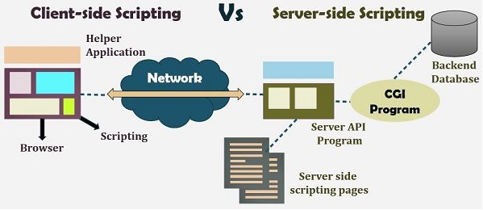
Client-side scripting Vs Server-side scripting

Slide 10
2. Introduction to Python
Contents
What is Python?
Features of python
Python in the real world
Installation of python
Python 2.* Vs 3.0*
Interactive and script mode
File extensions
What is Shebang?
Comments
print function syntax
Introduction to PyCharm IDE
Byte Code

Slide 11
1. What is Python?
It is both programming & scripting language
If the complete application is developed in Python, it is called Programming in Python.
Python – 100%
In case the application is developed in any other programming language and performs
some data processing using Python, then Python is referred to as scripting language.
Java – 90%
Python – 10%
Guido Van Rossum developed python which is derived from ABC (GPPL)

Slide 12
2. Features of python
Easy to Learn and use
Interpreted language
Cross-platform language( Mac, Windows, Linux and Unix)
Free and Open source
Object Oriented Language
Large standard library
GUI Programming
Easy to integrate with other languages like C, C++, Java etc
Has automatic memory management
Dynamical type
Automatic garbage collection
Has efficient high level data structures
Very fast - byte code

Slide 13
3. Python in the real world
Websites
Text Editors
Applications
Video Games
YouTube
Sublime Text
Blender
Battlefield2
Yahoo Maps
Koding
Openshot video editor
Civilization IV
Quora
NetBeans
Ubuntu Software centre
Vega Strike
Pinterest
PyCharm
BitTorrent
Unity of Command
Reddit
Geany
Juice
Bridge Commander

Slide 14
4. Installation of Python
Download the latest version of python from official website for
Windows/Linux/Unix/Mac from https://www.python.org/downloads/
2 versions of Python are in use
Python 3.x – Current version and is under active development
Python 2.x – Legacy version and will receive only security alerts until 2020
Verify if python is installed : python --version
python3 --version : if python 2 is also installed

Slide 15
5. Few differences between Python 2.* and 3.*
print function : print is a function in Python 3. It is much easier to read
Python 2:
print “Hello world!”
Python 3:
print(“Hello world!”)
input function : raw_input function to take the input from the user (like scanf in C)
in 2.* version is replaced with input function in 3.*
Python 2:
text = raw_input()
print text
Python 3:
text = input()
print(text)

Slide 16
Few differences between Python 2.* and 3.* (contd)
format function : Variables value is passed as an argument to format function in 3.*
Python 2:
training = "Python”
print "Hi, Welcome to %s session!" % training
Python 3:
training = "Python"
print("Hi, Welcome to {0} session!".format(training))

Slide 17
6. Interactive and script mode
Interactive mode :
Type ‘python’ in the terminal/run to get the python shell prompt
Once the python interpreter starts, we can issue any command in the command prompt.
Hello World Program in Python Vs C
>>> print("Hello World")
Hello World
>>>
>>>
#include <stdio.h>
void main()
{
printf("Hello World");
}

Slide 18
Interactive mode (contd)
IDLE is Python's Integrated Development and Learning Environment
The interactive mode of Python is also called REPL
Read: The read function accepts an input from the user and stores it into the memory.
Eval: The eval function evaluates this ‘input’ read from the memory.
Print: The print function prints the outcome from the eval function.
Loop: The loop function creates a loop and terminates itself when the program ends.
Try below computations in IDLE
a) ‘Hello’ b) 10+20 c) _ d) _*2
e) 3+2*4 f) 4/2=2.0 g) 4**2
h) for i in range(1,11):
print("7","*",i," = ",7*i)
i) s = “Hello”
s*3
s.upper()

Slide 19
6. Interactive and script mode (contd)
Script mode :
In the script mode, create a file from IDLE to write the script and
save it with a .py extension to run the script.
Interpreter will interpret the code line by line and computes the result on the
shell prompt.

Slide 20
7. File Extensions
Before 3.0 versions
.py == Python file(Regular scripts)
.py3 == (rarely used) Python3 script
.pyc == This is the compiled bytecode or compiled scripts
.pyd == This is basically a windows dll file
.pyo == This is optimized pyc file
.pyw == Python script for windows
.pyz == Python script archive (compressed or zip formatted)

Slide 21
8. What is Shebang?
The term shebang refers to #! which is seen as the first line in any script run as ‘script mode’
in Unix or Linux machines.
Alias names for Shebang are Hashbang / Pound-bang / Hash-pling / Crunchbang
The first line in the script #!/usr/bin/python points to the path of the associated program.
The purpose of shebang is for the script to recognize the interpreter type when you want to execute the script from the shell.
The usage of #!/usr/bin/python plays a role if the script is executable, and called without the proceeding language
Example:
#!/usr/bin/python
print(“Hello World”)

Slide 22
9. Comments
Anything after a # is ignored by Python (like // in C)
Single lined comment: #This is a single line comment (hash or pound)
Multi lined comment:
#This is a long comment
#and it extends to
#multiple lines
Statements / Strings enclosed within three double quotes or three single quotes are also
considered as multi line comments (like /* ... */ in C )
‘‘‘
This is a long comment
and it extends to
multiple lines
’’’
“““
#This is a long comment
#and it extends to
#multiple lines
”””

Slide 23
10. Print function
Syntax :
print(value1, .., sep=‘’, end=‘\n’, file=sys.stdout, flush=False)
Parameters :
objects - objects to be printed
sep - objects are separated by a seperator. Default value a space.
end - end is printed after printing all the objects. Default value is new line.
file - must be an object with write(string) method. By default it prints to stdout.
flush - If true, the stream is forcibly flushed. Default value: False
Try these Examples:
print(‘A’,’B’,’C’)
print(‘A’,’B’,sep=‘’)
print(‘A’,’B’,sep=‘’,end=‘@’)
print(’12’,’12’,sep=‘-’,end=‘’) # Date
print("Hello World!");xyz = 10; print(xyz)
# Use semicolon to include multiple statements in a single line
# Use backslash to continue the statement in next line
>>> a =10
>>> b = 20
>>> s = a + \
b
>>> print(s)
30

Slide 24
11. Introduction to IDE
Universal editor - Notepad is considered as a universal editor to develop pragrams.
Once we write the code in notepad, we have to execute it from command prompt to check the output.
It will not be helpful for developers as we don’t have options in notepad other than
create a new file / edit/ save etc.
An IDE consists of
Source Code editor
Build automation tools
A compiler/interpreter
A debugger
Python IDEs
IDLE (official)
Spider
Atom
PyCharm
Jupiter Notebook
PyCharm is an IDE specifically used for Python language.
Code analysis
Graphical debugger
An integrated unit tester
Integration with version control system
Supports web development with Django
Comes in 2 editions - Community (free) and Professional (paid)
PyCharm is cross functional and works on Windows, Linux and MacOS
Download from :
https://www.jetbrains.com/pycharm/download/#section=windows

Slide 25
12. Byte Code
Python is usually called an interpreted language, however, it combines compiling and interpreting.
When we execute a source code (a file with a .py extension), Python first compiles it into a bytecode.
The bytecode is a low-level platform-independent representation of your source code, however, it is not the binary machine code and cannot be run by the target machine directly.
In fact, it is a set of instructions for a virtual machine which is called the Python Virtual Machine (PVM).
After compilation, the bytecode is sent for execution to the PVM.
The PVM is an interpreter that runs the bytecode and is part of the Python system.
The bytecode is platform-independent, but PVM is specific to the target machine.
The default implementation of the Python programming language is CPython which is written in the C programming language.
CPython compiles the python source code into the bytecode, and this bytecode is then executed by the CPython virtual machine.

Slide 26
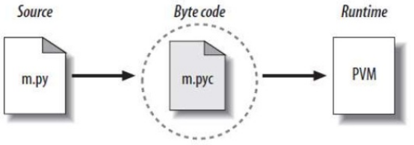
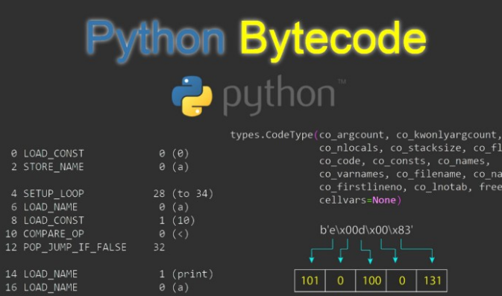
12. Byte Code (contd)
Try below script to view the byte code (save as a.py)
import dis
def hello():
print("Helloo, World!")
dis.dis(hello)
command to compile : python -m compileall a.py
In Python, the bytecode is stored in a .pyc file. In Python 3, the bytecode files are stored in a folder named __pycache__ in the project directory.

Slide 27
Contents
Variables
Rules to declare a variable
Identifiers and Constants
Camel case and Pascal case
Literals
Multiple assignment
Format function
Data types
Type function
Data conversions
math operations
id() function
Local and Global variables
Function declaration
3. Variables

Slide 28
1. Variables
A variable is a name that refers to a memory location where data is read and modified
Below 4 statements are valid in C but only 2 of them are valid in python.
int a # Declaration # Python doesn’t support declaration
a = 10 # Assignment # Valid
a = 10+20 # Modify/update # Valid
int a =30 # Initialization # Invalid as python doen’t need data type to store a value in a variable
A variable in python can hold any kind of value.
Ex:
a = 10 # The variable ‘a’ holds integer value
a = “Hello World” # the same variable now holds string
a = 2+j8 # ‘a’ holds a complex value
In python, every variable is an object of some class.

Slide 29
2. Variable name rules:
Python variables
Must begin with a letter (a-z, A-Z) or underscore ( _ )
Should be combination of characters of letters, numbers or _
Are Case sensitive
Can be of any reasonable length
Must not be a reserved word or keyword
Names should be written in camelCase
Examples:
123Var = ‘Python’ # starts with integer
Var@ = ‘Python’ # has special character
class = ‘Python’ # class is a keyword
All 3 statements will give SyntaxError: invalid syntax
123 = 1
print(123)
SyntaxError: cannot assign to literal

Slide 30
Python variables - Classification
Python variables can be classified under procedural oriented and object oriented programming.
Procedural:
Local variables (+ Function arguments)
Global variables
Objet oriented:
Local variables (+ Function arguments)
Global variables
Class level variables
Object level variables
Keywords
False | class | finally | is | return
None | continue | for | lambda | try
True | def | from | nonlocal | while
and | del | global | not | with
as | elif | if | or | yield
assert | else | import | pass
break | except | in | raise

Slide 31
3. Identifiers and Constants
Identifier is just the name of the variable/class/function
Examples:
MAX = 50 # variable name
fib_series() or fibSeries() # function name
class Employee(): # class name
Fixed values such as numbers, letters and strings are called “constants”
Examples:
MAX = 50
str = “Hello World”
a = ‘B’

Slide 32
4. Camel case and Pascal case
In Real Time Projects, camelCase is a naming convention in which a name is formed of multiple words that are joined together as a single word for better readability.
Examples : “iPhone”, “eBay”, “FedEx”, “PayPal” etc
NOTE: From Programmer’s perspective, PascalCase means the first char of the first word should be capitalized while camelCase means the first char of the first word should be lowercased
Function names and identifiers are usually written in came case where as class names are written in pascal case
Examples :
fibanocciSeries()
class EmployeeInfo():

Slide 33
5. Literals
A literal is a notation for representing a fixed value.
Python supports the following literals :
String literals
Numeric literals
Boolean literals
Special literals
Literal Collections
Examples :
intVar = 100 Numeric literal
floatVar = 100.00 Numeric float literal
complexVar = complex(1,2) Numeric complex literal
strVar = “Python” String literal
boolVar = True Boolean literal
noneVar = None Represents absence of a value
listVar = [1,2,3,4,5] List literal
tupleVar = (1,2,3,4,5) Tuple literal
setVar = {1,2,2,3,4} Set literal
dictVar = {1:”ONE”, 2: “TWO”} Dictionary literal
Note: All the variables are declared in came case

Slide 34
6. Multiple assignment
Python allows assigning single value to multiple variables simultaneously in one statement.
Examples :
>>> a = b = c = 5
>>> print(a,b,c)
5 5 5
>>>
>>> a, b, c, d = 10, 20.5, "Python", True
>>> print(a,b,c,d)
10 20.5 Python True
>>>
>>> print(d,c,b,a)
True Python 20.5 10
>>>
a = None = 2 # SyntaxError: cannot assign to None

Slide 35
7. format() function
It returns a formatted representation of the given value controlled by the format specifier.
Syntax : format(value, “format_specifier”)
Examples :
>>> txt = "My name is {fname}, I'm {age} years old.".format(fname = "Dolly", age = 2)
>>> txt
"My name is Dolly, I'm 2 years old."
>>>
>>> txt = "My name is {0}, I'm {1} years old.".format("Dolly",2)
>>> txt
"My name is Dolly, I'm 2 years old."
>>>
>>> txt = "My name is {}, I'm {} years old.".format("Dolly",2)
>>> txt
"My name is Dolly, I'm 2 years old."
>>>

Slide 36
8. Datatypes
Python is an object-orientated language, and as such it uses classes to define data types, including its primitive types.
Every element in a Python program is an object of a class.
A number, string, list, dictionary, etc. used in a program is an object of a corresponding built-in class.
Examples:
a = 10 # The variable ‘a’ is an object of class ‘integer’
str = “Python” # str is an object of class ‘string’
value =10.20 # value is an object of class ‘float’
comp = 2+j8 # comp is an object of class ‘complex’
b = 10 # b is an object that points to the same memory location as a
# a and b are different object of the same class ‘integer’
a = “Python” # a now becomes an object of ‘string’ class and points to the same memory
location that str variable points to.

Slide 37
9. type() function
In Python, the data type is set when you assign a value to a variable.
type() function is used to get the data type of the variable.
(i.e., it returns the the class to which that variable is object of)
Examples :
>>> a = 10
>>> type(a)
<class 'int'>
>>>
>>> str = "Python"
>>> type(str)
<class 'str'>
>>>
>>> value = 10.20
>>> type(value)
<class 'float'>
>>>
>>> comp = complex(2,8) # complex() function is used to generate
complex numbers
>>> print(comp)
(2+8j)
>>> type(comp)
<class 'complex'>
>>>

Slide 38
Typecasting:
Converting from one data type to another.
There are two types of conversions.
1. Implicit
2. Explicit
Example of Implicit type conversion:
>>> a = 10
>>> b = 0.5
>>> c = 0
>>> type(c)
<class 'int'>
>>> c = a+b
>>> type(c)
<class 'float'>
>>>
Examples of Explicit type conversion:
>>> a =10
>>> float(a)
10.0
>>> b = 10.5
>>> int(b)
10
>>>
>>> int("Python")
gives Value Error
>>> comp = complex(2,8)
>>> print(comp)
(2+8j)
>>> int(comp)
gives Type Error

Slide 39
10. Data conversion functions
Python library provides predefined functions to convert the data from one type to another type.
1) int() -> converts input value to integer
2) chr() -> takes a value and gives its ascii char
s=“100” ints(s) 100
f=“35.5 int(f) 35
b=True int(b) 1
s=“Python” int(s) value error
int(‘a’) value error
s=“65” chr(x) A
x=100 chr(x) d
chr(‘#’) Type error
chr(1.5) ?
3) ord() -> returns constant integer value of
specified character
4) float() -> converts input value to float value
x=‘A’ ord(x) 65
ord(‘a’) 97
ord(1) 49
s=“65.5” float(s) 65.5
x=10 float(x) 10.0
X=“abc” float(x) value error
Refer : https://www.tutorialspoint.com/data-type-conversion-in-python

Slide 40
11. Math Operations
Below are some of the math operations that can be performed with in built functions.
import math module to access some of these functions.
cmp(a, b) compare two numbers
exp(a) exponential of ‘a’.
ceil(a) smallest integer which is not less than ‘a’.
floor(a) find the largest integer that is not larger than ‘a’.
abs(a) absolute value of ‘a’,
sqrt(a) square root of ‘a’.
log(a) natural logarithmic value of ‘a’.
log10(a) base-10 algorithmic value of ‘a’.
Examples:
>>> import math
>>> math.ceil(10.7)
11
>>> math.floor(10.7)
10
>>> abs(-7)
7
>>> math.sqrt(16)
4.0
>>>
>>> math.log(10)
2.302585092994046
>>> math.log10(10)
1.0
>>>

Slide 41
11. id() function
In Python, every object has its own unique id.
Every time you create an object, a unique id is assigned to it.
The id() function returns the identity of any Python object.
This will return an integer identification number for different objects.
>>> id(1)
2007496624
>>> x=1
>>> id(x)
2007496624
>>> y='Python‘
>>> id(y)
6957056
>>> id('Python')
6957056
>>> id('python')
45410976
>>> id(1.0)
45399600
>>> id(1.00)
15254992
>>> id(3)
2007496656
>>> id(1+2)
2007496656
>>> x=2+1
>>> id(x)
2007496656

Slide 42
11. id() function (contd)
Python stores the list of all the integers in sequential blocks, which are equally spaced
The difference between the id numbers of two integers is 2 bytes.
>>> id(1)
2007496624
>>> id(2)
2007496640
>>> id(3)
2007496656
>>> id(4)-id(5)
-16
>>> id(150)-id(149)
16
>>> 2007496640 - 2007496624
16
>>> 2007496656 - 2007496640
16
The underlying CPython implementation uses the id() function as the address of the object, in memory.
is keyword is used for identity (id) comparison,
while == operator is used for equality (value) comparison.
>>> x=10
>>> y=x
>>> print(x is y) # x and y point to same memory location that has value 10 which is the object of class integer.
True

Slide 43
13. Function Declaration
A function is declared using ‘def’ keyword.
The block starts with a colon
All the statements that belongs to the function definition takes one tab space or 4 spaces
from the start of the function.
Indentation must be followed strictly to avoid compile time errors and to get expected output
def sum(): # sum function definition starts with def keyword
print("In sum function") # takes 4 spaces to be part of the function definition
return
def diff(): # diff function definition
print("In diff function")
return
sum() # function call to sum
diff() # function call to diff

Slide 44
14. Local and Global Variables
Local variables belong to a function.
They can be function parameters or variables declared inside a function.
Example 1 :
def m1():
a=10 # local variable
print(a)
return
def m2():
print(a) # name error
return
m1()
m2()
Example 2 :
def m1():
a=10 # local to m1
print(a)
return
def m2():
a=20
print(a) # local to m2
return
m1()
m2()
Example 3 :
def m1():
a=10 # local to m1
print(a)
return
def m2(a): # local to m2
print(a)
return
m1()
m2(20)

Slide 45
Local and Global Variables (contd)
Declaration of variable outside to all the functions is called a global variable.
Global variables can be accessed from all the functions.
Can be accessed inside the function but first priority is given to local variable.
If local variable with same name is not available, then it will access global variable.
Example 1 :
a = 30 # global variable
def m1():
print(a)
return
def m2():
a=20 # local variable
print(a)
return
m1()
m2()
We cannot modify global variables directly within the functions.
Use global keyword to modify global variable inside a function
Example 2 :
a = 20
def test():
a = a + 10 # gives error
return
test()
Example 3 :
a = 20
def test():
global a
a = a + 10
print(a) # inside fun
return
test()
print(a) # outside fun

Slide 46
4. Operators
Contents
Arithmetic Operators
Comparison (Relational) Operators
Assignment Operators
Logical Operators
Bitwise Operators
Membership Operators
Identity Operators

Slide 47
Operator is a symbol that performs operation on one or more operands
X = 10 + int(35.5)
All 3 are operands,
+ and = are operators
Python supports the following types of operators.
Arithmetic Operators
Comparison (Relational) Operators
Assignment Operators
Logical Operators
Bitwise Operators
Membership Operators
Identity Operators

Slide 48
Arithmetic Operators
Operator | Description | Examples
+ Addition | Adds values on either side of the operator. | 5+3-2 # +, - having same priority , left to right evaluation
- Subtraction | Subtracts right hand operand from left hand operand | 5+3*2 # * having higher priority than + >>> '10'+'20‘ # concatenation '1020'
* Multiplication | Multiplies values on either side of the operator | (5+3)*2 # () having higher priority than all arithmetic operator
/ Division | Divides left hand operand by right hand operand | >>> 5/2 = 2.5 ; >>> 5//2 = 2 >>> 2.5**2 = 6.25 ;
% Modulus | Divides left hand operand by right hand operand and returns remainder
** Exponent | Performs exponential (power) calculation on operators | >>> 25 % -6 = -5 >>> 'a'*4 >>> -25 % -6 = ? 'aaaa'
// Floor division | The division of operands where the result is the quotient in which the digits after the decimal point are removed.

Slide 49
Relational Operators
Operators | Description | Examples | More Examples
== | If the values of two operands are equal, then the condition becomes true. | >>> 5>3 True | >>> 1 == int(1.00000) True
!= | If values of two operands are not equal, then condition becomes true. | >>> 3>3 False | >>> 3!=3.0 False
> | If the value of left operand is greater than the value of right operand, then condition becomes true. | >>> 1==True True | >>> None == True False
< | If the value of left operand is less than the value of right operand, then condition becomes true. | >>> 0 == False True | >>> None == False False
>= | If the value of left operand is greater than or equal to the value of right operand, then condition becomes true. | >>> 25.00 <= 25.000 True | >>> 25.00 >= 25.00000 True
<= | If the value of left operand is less than or equal to the value of right operand, then condition becomes true. | >>> False+1 == True True | >>> 25.0 == 25.000000 True >>> 25.0 == 25.00000000009 False

Slide 50
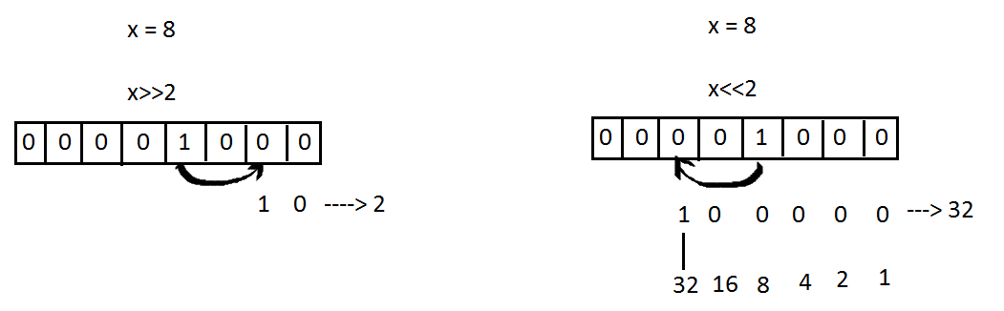
Bitwise Operators
For x = 10 (0000 1010) and
y = 4 (0000 0100)
Operator | Description | Examples
& Binary AND | Operator copies a bit to the result if it exists in both operands | x & y = 0 (0000 0000)
| Binary OR | It copies a bit if it exists in either operand. | x | y = 14 (0000 1110)
^ Binary XOR | It copies the bit if it is set in one operand but not both. | x ^ y = 14 (0000 1110)
~ Binary Ones Complement | It is unary and has the effect of 'flipping' bits. | ~x = -11 (1111 0101)
<< Binary Left Shift | The left operands value is moved left by the number of bits specified by the right operand. | x >> 2 = 2 (0000 0010)
>> Binary Right Shift | The left operands value is moved right by the number of bits specified by the right operand. | x << 2 = 32 (0010 0000)

Slide 51
Assignment Operators
Operator | Example | Equivalent to
= | x = 5 | x = 5
+= | x += 5 | x = x + 5
-= | x -= 5 | x = x - 5
*= | x *= 5 | x = x * 5
/= | x /= 5 | x = x / 5
%= | x %= 5 | x = x % 5
//= | x //= 5 | x = x // 5
**= | x **= 5 | x = x ** 5
&= | x &= 5 | x = x & 5
|= | x |= 5 | x = x | 5
^= | x ^= 5 | x = x ^ 5
>>= | x >>= 5 | x = x >> 5
<<= | x <<= 5 | x = x << 5

Slide 52
Logical Operators
For x = 10 (0000 1010) and
y = 4 (0000 0100)
Operator | Description | Examples
and Logical AND | If both the operands are true then condition becomes true. | >>> x and y 4 >>> x and False False
or Logical OR | If any of the two operands are non-zero then condition becomes true. | >>> x or y 10 >>> y or True 4
not Logical NOT | Used to reverse the logical state of its operand. | >>> not x False >>> not 0 True >>> not True False
>>> 5>3 and 5!=5
False
>>> 3>5 or 5>3
True
>>> not 'Python'
False
>>> not ""
True
>>> not None
True
>>> not 3!=3
True

Slide 53
Membership Operators
in and not in are the membership operators in Python.
They are used to test whether a value or variable is found
in a sequence string, list, tuple, set and dictionary).
In a dictionary we can only test for presence of key, not the value.
Example :
a = 1
b = 20
list = [1, 2, 3, 4, 5 ]
if ( a in list ): print("a is available in the given list")
else: print ("a is not available in the given list")
if ( b not in list ): print ("b is not available in the given list")
else: print ("b is available in the given list")
Operator | Description | Example | Example
in | Evaluates to true if it finds a variable in the specified sequence and false otherwise. | 5 in x | >>> s = 'Python' >>> 'y' in s True
not in | Evaluates to true if it does not finds a variable in the specified sequence and false otherwise. | 5 not in x | >>> 'py' in s False >>> 'Py' in s True

Slide 54
Identity Operators
is and is not are the identity operators in Python.
They are used to check if two values (or variables) are
located in the same part of the memory.
Two variables that are equal does not imply that they
are identical.
Example :
x = ["apple", "banana"]
y = ["apple", "banana"]
z = x
print ("memory location of x = ",id(x))
print ("memory location of y = ",id(y))
print ("memory location of z = ",id(z))
print(x is z)
# returns True because z is the same object as x
print(x is y)
# returns False because x is not the same object as y,
# even if they have the same content
print(x == y)
# to demonstrate the difference between "is" and "==":
# this comparison returns True because x is equal to y
Operator | Description | Example | Example
is | True if the operands are identical (refer to the same object) | x is True | >>> x=5 >>> y=5 >>> x is y True >>> id(x) is id(y) False
is not | True if the operands are not identical (do not refer to the same object) | x is not True | >>> id(x) 2007496688 >>> id(y) 2007496688

Slide 55
Operators - from highest precedence to lowest
Operator | Description
** | Exponentiation (raise to the power)
~ + - | Complement, unary plus and minus
* / % // | Multiply, divide, modulo and floor division
+ - | Addition and subtraction
>> << | Right and left bitwise shift
& | Bitwise 'AND'
^ | | Bitwise exclusive `OR' and regular `OR'
<= < > >= | Comparison operators
<> == != | Equality operators
= %= /= //= -= += *= **= | Assignment operators
is, is not | Identity operators
in, not in | Membership operators
not or and | Logical operators
Example :
a = 20
b = 10
c = 15
d = 5
e = 0
e = (a + b) * c / d #( 30 * 15 ) / 5
print(e)
e = ((a + b) * c) / d # (30 * 15 ) / 5
print(e)
e = (a + b) * (c / d) # (30) * (15/5)
print(e)
e = a + (b * c) / d # 20 + (150/5)
print(e)

Slide 56
5. Control Structures
Contents
Sequential
Selection based
Iteration

Slide 57
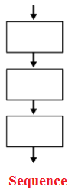
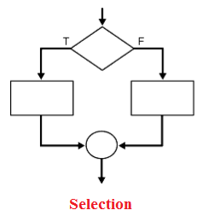
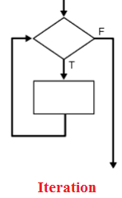
Control Statements
Flow of control through any given program is implemented with three basic types of control structures:
Sequential, Selection and Repetition.

Slide 58
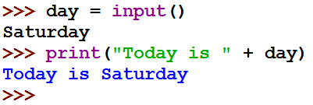
Sequence
The statements get exectued sequentially.
Eaxmples :
print("First Line")
print("Second Line")
print("Third Line")

Slide 59
Selection (Conditional)
if statement ( One-Way decision)
if .. else statement (Two-way decision)
if .. elif .. else statement (Multi-way decision)
4. Nested if .. else (inner decisions)
Relational Operators are used on
> >= < <= == !=
x = int(input())
if x >= 0:
if x ==0:
print("x is 0")
else:
print("x is +ve")
else:
print("x is -ve")
if x > 0:
print(“x is +ve”)
if x > 0:
print(“x is +ve”)
else:
print(“x is not +ve”)
x = int(input())
if x > 0:
print("x is +ve")
elif x <0:
print("x is -ve")
else:
print("x is 0")

Slide 60
Iteration (Loops)
for
2. while
3. Nested loops
4. break and continue (loop control)
Example 1 :
for x in ["c","c++","Python"]:
print(x)
Example 2 :
a=10
while a>0:
print(" a is : ",a)
a=a-2
Example 3 :
for a in [1,2]:
for b in [1,2]:
print(a,b)
Output :
a is : 10
a is : 8
a is : 6
a is : 4
a is : 2
Output :
1 1
1 2
2 1
2 2
Output :
c
c++
Python

Slide 61
Iteration (contd)
A Pass statement in Python is used when we cannot decide what to do in our code, but we must type something for making syntactically correct.
Break helps in controlling the Python loop by breaking the current loop from execution and transfer the control to the next block.
A continue also helps in controlling the Python loop but by making jumps to the next iteration of the loop without exhausting it.
pass break
continue
Example 1 :
for letter in 'Python':
if letter == 'h':
pass
print("pass :",letter)
print(letter)
Example 2 :
for letter in 'Python':
if letter == 'h':
print("In if :",letter)
break
else:
print("letter :",letter)
Example 3 :
for letter in 'Python':
if letter == 'h':
print("In if :",letter)
continue
else:
print("letter :",letter)

Slide 62
range()
Range function returns a list of consequetive numbers till the number specified in stop (argument).
range(stop) - starts from 0 till (stop-1)
range(start, stop) - ends at (stop -1); start>stop
range(start, stop, step) - step cannot be 0, default is 1
for a in [1,2]:
for b in [1,2]:
print(a,b)
for a in range(3):
for b in range(3):
print(a,b)
for a in range(1,3):
for b in range(1,3):
print(a,b)
for a in range(1,5,1):
for b in range(1,5,1):
print(a,b)
for a in range(7,1,-1):
for b in range(7,1,-1):
print(a,b)
a=7
for x in range(1,11,1):
print(a,'*',x,'=',a*x)
y=7
count=0
for x in range(1,78):
if x%y==0:
count+=1
print(count)

Slide 63
6. Functions
Contents
Types of Functions
General classification
Default Arguments
Required Arguments
Keyword Arguments
Variable Arguments
Lambda expression
Filter function
Map function

Slide 64

Types of Functions
1. Built-in functions
print() | map() | enumerate() | le() | oct()
input() | filter() | help() | max() | pow()
abs() | bin() | id() | min() | type()
2. User defined functions
def fun(name): # fun is user defined function definition
print("We are in " + name + " session") # print is in built function
training = input("Training name : ") # input is user defined function
fun(training) # fun is user defined function call

Slide 65
General classification of functions
1. Function without arguments and without return type
2. Function without arguments, with return type
3. Function with arguments without return type
4. Function with arguments and with return type
1 :
def func():
print("Case 1")
return
func()
2 :
def func():
print("Case 1")
return 200
x= func()
print(x)
3 :
def func(a,b):
print("a:",a)
print("b:",b)
return
func(10,20)
4 :
def func(a,b):
print("a:",a)
print("b:",b)
return a*b
print(func(10,20))
Python supports below function types
1. Default arguments function
2. Required arguments function
3. Keyword arguments function
4. Variable arguments function

Slide 66
Default Argument Function
Function accepts atleast one default value.
If a value is passed to default argument, the default value gets replaced with the new value.
Example 1 :
def defaultArgs(a,b,c=10):
print("a = ",a,"b = ",b,"c = ",c)
return
defaultArgs(10,20)
defaultArgs("Java","Python")
defaultArgs(10,20,30)
defaultArgs(10,20,"Python")
Example 2 :
def defaultArgs(a,b,c=10):
print("a = ",a,"b = ",b,"c = ",c)
return
defaultArgs(10)
TypeError: defaultArgs() missing 1 required positional argument: 'b'
Example 3 :
def defaultArgs(a=10,b):
print("a = ",a,"b = ",b)
return
defaultArgs(10)
Output :
a = 10 b = 20 c = 10
a = Java b = Python c = 10
a = 10 b = 20 c = 30
a = 10 b = 20 c = Python
SyntaxError: non-default argument follows default argument

Slide 67
Required Argument Function
Number of arguments passed in the function call should match with the number in function definition.
Example 1 :
def requiredArgs(a,b,c):
print("a = ",a,"b = ",b,"c = ",c)
return
requiredArgs(10,20,30)
requiredArgs("Java","Python",40)
requiredArgs(55,65,"Python")
Example 2 :
def requiredArgs(a,b,c):
print("a = ",a,"b = ",b,"c = ",c)
return
requiredArgs(10,30)
Example 3:
def requiredArgs(a,b,c):
print("a = ",a,"b = ",b,"c = ",c)
return
requiredArgs(10,20,30,40)
TypeError: requiredArgs ()
missing 1 required
positional argument: 'c'
TypeError: requiredArgs ()
takes 3 positional arguments
but 4 were given
Output :
a = 10 b = 20 c = 30
a = Java b = Python c = 40
a = 55 b = 65 c = Python

Slide 68
Keyword Argument Function
Function arguments has a keyword to accept its value.
Keyword in function call and function definition should match.
Example 1 :
def keywordArgs(emp,exp):
print(emp,"exp = ",exp)
return
keywordArgs(emp="pqr",exp=2)
keywordArgs(emp="xyz",exp=3)
keywordArgs(exp=4,emp="abc")
Example 2 :
def keywordArgs(emp,exp,org="TS"):
print(emp,“exp = ",exp,"in ",org)
return
keywordArgs(emp="pqr",exp=2)
Output :
pqr exp = 2 in TS
Output :
pqr exp = 2
xyz exp = 3
abc exp = 4
Try below calls in Example 2:
keywordArgs(exp=4,empname="abc")
Gives TypeError: keywordArgs() got an unexpected keyword argument 'empname'
keywordArgs(exp=4,emp="abc",org="TS")
Gives TypeError: keywordArgs() got an unexpected keyword argument 'org'

Slide 69
Variable Argument Function
Accepts any number of arguments.
Example 1 :
def variableArgs(*a):
print("list:",a)
return
variableArgs(10,20)
variableArgs(10,20,30,40)
variableArgs(10,20,"Python")
Example 2 :
def variableArgs(*a):
print("list:",a)
return
variableArgs()
Output :
list: (10, 20)
list: (10, 20, 30, 40)
list: (10, 20, 'Python')
Output :
list: ()

Slide 70
Lambda expressions
Lambda is a predefined keyword – defines functions as expressions.
A lambda function can take any number of arguments, but can only have one expression.
Syntax : lambda arguments : expression
x = lambda a : a + 10 # lambda expression, a takes the value 5
print(x(5))
print(type(x)) # Returns function object - <class 'function'>
def add(x,y):
return x + y # This is same as lambda x, y: x + y
Uses:
When we require a nameless function for a short period of time
lambda expression is passed as an arguments to in-built functions like filter(), map(), reduce()

Slide 71
Examples
def switch_func(value, x):
return {
'a': lambda x: x+122,
'b': lambda x: x*2,
'c': lambda x: x-123,
'd': lambda x: x/2
}.get(value)(x)
# take user input
inp = input('input a character : ')
print('The result for inp is : ', switch_func(inp, 2))
def factorial(x):
if x==1:
return 1
else:
return (x*factorial(x-1))
n = int(input("Enter n: "))
print(factorial(n))

Slide 72
filter()
Arguments : function and a list
Returns : a new list contains items for which the function evaluates to True
Example :
seq = [1,5,4,6,8,11,3,12]
even_list = filter(lambda x : x%2==0, seq)
print(list(even_list))
odd_list = filter(lambda x : x%2!=0, seq)
print(list(odd_list))
Output :
[4, 6, 8, 12]
[1, 5, 11, 3]

Slide 73
map()
Arguments : function and a list
Returns : a new list contains items returned by that function for each item
Example 1 :
seq = [1,5,4,6,8,11,3,12]
new_seq = map(lambda x : x*2, seq)
print(list(new_seq))
Example 3:
def newfunc(a):
return a*a
x = map(newfunc, (1,2,3,4)) #x is the map object
print(list(x))
Output : [2, 10, 8, 12, 16, 22, 6, 24]
Example 2 :
seq = [1,5,4,6,8,11,3,12]
new_seq = map(lambda x : x%2==0, seq)
print(list(new_seq))
Output : [1, 4, 9, 16]
Output : [False, False, True, True, True, False, False, True]

Slide 74
7. Strings
Contents
Characteristics of Strings
Escape sequences
Format specifiers
Indexing
Slicing
Built-in functions
Special Operators

Slide 75
Characteristics of Strings
Strings are immutable sequence of characters.
Strings are inserted either in double quotes or single quotes.
Multi line Strings are inserted between three double quotes or three single quotes.
str1 = "Python"
print("str1 : ",id(str1))
str2 = "Python"
print("str2 : ",id(str2))
str1 = str1 + str2 # immutable
print("str1 : ",id(str1))
Output:
str1 : 5974016
str2 : 5974016
str1 : 46055040
a = 'This 'Python tutorial' is for you'
SyntaxError: invalid syntax
a = "This 'Python tutorial' is for you"
# Single quote within double quotes and vice versa is valid
a = "This "Python tutorial" is for you"
SyntaxError: invalid syntax
a = 'This "Python tutorial" is for you'
a = "Python's strings tutorial"
a = """This Python tutorial
is for you""" # Multi line string

Slide 76
Escape Sequence
It is recommended to use escape characters(\) while working with strings.
Few escape characters :
\n --> New line character
\t --> Tab space
\\ --> \
\' --> '
\" --> "
>>> msg = "This \'python tutorial\' makes you perfect"
>>> print(msg)
This 'python tutorial' makes you perfect
>>>
>>> path="Path to Python : C:\\Python\\training"
>>> print(path)
Path to Python : C:\Python\training
>>>
To print Tic Tac Toe:
X O X
X X X
O O O
>>> tictactoe = "X\tO\tX\nX\tX\tX\nO\tO\tO"
>>> print(tictactoe)

Slide 77
Format Specifiers
The "%" operator is used to format a set of variables enclosed in a "tuple" (a fixed size list),
together with a format string, which contains normal text together with "argument specifiers",
special symbols like "%s" and "%d".
>>> x=12.3456
>>> print("int value: %d" %x)
int value: 12
>>> print("float value: %f" %x)
float value: 12.345600
>>> print("int value: %0.2f" %x)
int value: 12.35
>>>
>>> lang = "Python"
>>> print("%s is easy to learn" %lang)
Python is easy to learn
>>>
>>> name = "Annie"
>>> age = 6
>>> print("%s age is %d" %(name,age))
Annie age is 6
>>>

Slide 78
Indexing
Individual characters can be accessed using index.
Positive index starts from 0 from left to right.
Negative indexing starts from -1 from right to left.
s = "PYTHON"
print("s[0] : ",s[0])
print("s[1] : ",s[1])
print("s[2] : ",s[2])
print("s[3] : ",s[3])
print("s[4] : ",s[4])
print("s[5] : ",s[5])
print("s[-1] : ",s[-1])
print("s[-2] : ",s[-2])
print("s[-3] : ",s[-3])
print("s[-4] : ",s[-4])
print("s[-5] : ",s[-5])
print("s[-6] : ",s[-6])
Output :
s[0] : P
s[1] : Y
s[2] : T
s[3] : H
s[4] : O
s[5] : N
s[-1] : N
s[-2] : O
s[-3] : H
s[-4] : T
s[-5] : Y
s[-6] : P
>>>
# Print characters in the string using loop
s = "PYTHON"
c = 0
for i in s:
print("s[%d] : " %c,i)
c+=1

Slide 79
Slicing
Strings can be sliced using index.
Positive index starts from 0 from left to right.
Negative indexing starts from -1 from right to left.
Use [Inclusive number : Exclusive number] to slice.
Use [Inclusive : Exclusive : Step] to step and slice.
s = "PYTHON"
print(s[1:4])
print(s[1:]) # from index to end
print(s[:4]) # from 0 to 3
print(s[:]) # from 0 till end
print(s[-4:-2])
print(s[-5:4])
print(s[1:4:2]) # step 2 characters
print(s[-1:-6:-2])
Output :
YTH
YTHON
PYTH
PYTHON
TH
YTH
YH
NHY
>>>
# Deleting string
s = "STRING"
print(s[1:4])
del(s)
print(s)

Slide 80
Built in functions
S. No | String Methods | Example
1 | str.capitalize() Returns a string with the first letter capitalized | >>> str = "python is easy" >>> str.capitalize() 'Python is easy'
2 | str.center(width[, fillchar]) Returns a string padded with specified fillchar | >>> new_str = str.center(24, '*') >>> print(new_str) *****python is easy*****
3 | str.casefold() Removes all case distinctions present in a string. It is used for caseless matching, i.e. ignores cases when comparing. For example, the German lowercase letter ß is equivalent to ss | firstString = "der Fluß" secondString = "der Fluss" if firstStr.casefold() == secondStr.casefold(): print('The strings are equal.') else: print('The strings are not equal.')
4 | str.count(substring, start=..., end=...) Returns the number of occurrences of the substring in the given string. | string = "Python is easy, isn't it?" substring = "is" count = string.count(substring) print("The count is:", count)

Slide 81
Built in functions(contd)
S. No | String Methods | Example
5 | str.endswith(suffix[, start[, end]]) Returns True if a string ends with the specified suffix. If not, it returns False. | text = "Python is easy to learn." result = text.endswith('to learn') print(result) # False result = text.endswith('to learn.') print(result) # True
6 | str.expandtabs(tabsize) The expandtabs() returns a string where all '\t' characters are replaced with whitespace characters until the next multiple of tabsize parameter.
7 | str.encode(encoding='UTF-8',errors='strict') It returns utf-8 encoded version of the string. In case of failure, it raises a UnicodeDecodeError exception. | str = 'pythön!' res = str.encode() print(res) # b'pyth\xc3\xb6n!'
8 | str.find(sub[, start[, end]] ) The find() method returns an integer value: If the substring exists inside the string, it returns the index of the first occurence of the substring. If substring doesn't exist inside the string, it returns -1. | str = 'pythön is easy' res = str.find('is') print(res)

Slide 82
Built in functions(contd)
S. No | String Methods | Example
9 | template.format(p0, p1, ..., k0=v0, k1=v1, ...) Here, p0, p1,... are positional arguments and, k0, k1,... are keyword arguments with values v0, v1,... respectively. Template is a mixture of format codes with placeholders for the arguments. | >>> "Hi {0}, Welcome to {1} session".format("All","Python") Output: 'Hi All, Welcome to Python session'
10 | str.index(sub[, start[, end]] ) If substring exists inside the string, it returns the lowest index in the string where substring is found. If substring doesn't exist inside the string, it raises a ValueError exception. | >>> str = 'Python programming is fun.' >>> res = str.index('is fun') >>> print(res) 19
11 | str.isalnum() Returns True if all characters in the string are alphanumeric, False if at least one character is not alphanumeric | >>> str = "Py2tho3n" >>> print(str.isalnum()) True
12 | str.isalpha() Returns True if all characters in the string are alphabets (can be both lowercase and uppercase). False if at least one character is not alphabet. | >>> str = "Py2tho3n" >>> print(str.isalpha()) False

Slide 83
Built in functions(contd)
S. No | String Methods | Example
13 | str.isdecimal() Returns True if all characters in the string are decimal characters. False if at least one character is not decimal character. | >>> str = "12345" >>> print(str.isdecimal()) True
14 | str.isdigit() Returns True if all characters in the string are digits. False if at least one character is not a digit. In Python, superscript and subscripts (usually written using unicode) are also considered digit characters. Hence, if the string contains these characters along with decimal characters, isdigit() returns True. | >>> str = '10²' >>> print(str.isdecimal()) False >>> print(str.isdigit()) True
15 | str.isidentifier() Returns True if the string is a valid identifier False if the string is not a invalid identifier | >>> str = 'Py thon' >>> print(str.isidentifier()) False
16 | str.islower() True if all alphabets that exist in the string are lowercase alphabets. False if the string contains at least one uppercase alphabet. | >>> str = "Python" >>> print(str.islower()) False

Slide 84
Built in functions(contd)
S. No | String Methods | Example
17 | str.isnumeric() Returns True if all characters in the string are numeric characters. False if at least one character is not a numeric character. | >>> str = "½" >>> print(str.isnumeric()) True
18 | str.isprintable() Returns True if the string is empty or all characters in the string are printable False if the string contains at least one non-printable character | >>> str = '\nNew Line is printable' >>> print(str.isprintable()) False >>> str ="" >>> print("Empty string",str.isprintable()) Empty string True
19 | str.isspace() Returns True if all characters in the string are whitespace characters False if the string is empty or contains at least one non-printable character | >>> str = ' \t' >>> print(str.isspace()) True
20 | str.istitle() Returns True if the string is a titlecased string False if the string is not a titlecased string or an empty string | >>> str = 'Python Is Easy.' >>> print(str.istitle()) True

Slide 85
Built in functions(contd)
S. No | String Methods | Example
21 | str.isupper() Returns True if all characters in a string are uppercase characters False if any characters in a string are lowercase characters | >>> str = "PYTHON" >>> print(str.isupper()) Truestring.join(iterable)
22 | str.join(iterable) Returns a string created by joining the elements of an iterable by string separator. | >>> s1 = "!" >>> s2 = "Welcome" >>> print(s1.join(s2)) W!e!l!c!o!m!e
23 | str.ljust(width[, fillchar]) The ljust() method returns the left-justified string within the given minimum width. If fillchar is defined, it also fills the remaining space with the defined character. | >>> str = "Python >>> print(str.ljust(10,"*")) Python****
24 | str.rjust(width[, fillchar]) The rjust() method returns the right-justified string within the given minimum width. If fillchar is defined, it fills the remaining space with the defined character. | >>> str = "Python" >>> print(str.rjust(10,"-")) ----Python

Slide 86
Built in functions(contd)
S. No | String Methods | Example
25 | str.lower() lower() method returns the lowercased string from the given string. It converts all uppercase characters to lowercase. If no uppercase characters exist, it returns the original string. | >>> str = "pYtHoN" >>> print(str.tolower()) python
26 | str.upper() upper() method returns the uppercased string from the given string. It converts all lowercase characters to uppercase. If no lowercase characters exist, it returns the original string. | >>> str = "pYtHoN" >>> print(str.upper()) PYTHON
27 | str.swapcase() swapcase() method returns the string where all uppercase characters are converted to lowercase, and lowercase characters are converted to uppercase. | >>> str = "pYtHoN" >>> print(str.swapcase()) PyThOn
28 | str.lstrip([chars]) lstrip() returns a copy of the string with leading characters stripped. All combinations of characters in the chars argument are removed from the left of the string until the first mismatch. | >>> str = " Python" >>> print(str) Python >>> print(str.lstrip()) Python

Slide 87
Built in functions(contd)
S. No | String Methods | Example
29 | str.rstrip([chars]) The rstrip() returns a copy of the string with trailing characters stripped. All combinations of characters in chars argument are removed from the right of the string until first mismatch. | >>> str = "Python " >>> print(str.rstrip()) Python >>>
30 | str.strip([chars]) strip() returns a copy of the string with both leading and trailing characters stripped. | >>> str = " Python " >>> print(str.strip()) Python
31 | str.partition(separator) The partition method returns a 3-tuple containing: the part before the separator, separator parameter, and the part after the separator if the separator parameter is found in the string the string itself and two empty strings if the separator parameter is not found | >>> string = "Python is fun" >>> print(string.partition('is ')) ('Python ', 'is ', 'fun') >>> print(string.partition('not ')) ('Python is fun', '', '') >>> string = "Python is fun, isn't it" >>> print(string.partition('is')) ('Python ', 'is', " fun, isn't it") >>>

Slide 88
Built in functions(contd)
S. No | String Methods | Example
32 | str.rpartition(separator) rpartition() method returns a 3-tuple containing: the part before the separator, separator parameter, and the part after the separator if the separator parameter is found in the string two empty strings, followed by the string itself if the separator parameter is not found | >>> string = "Python is fun" >>> print(string.rpartition('is ')) ('Python ', 'is ', 'fun') >>> print(string.rpartition('not ')) ('', '', 'Python is fun') >>> string = "Python is fun, isn't it" >>> print(string.rpartition('is')) ('Python is fun, ', 'is', "n't it")
33 | str.replace(old, new [, count]) The replace() method can take maximum of 3 parameters: old - old substring you want to replace new - new substring which will replace the old substring count (optional) - the number of times you want to replace the old substring with the new substring | >>> song = 'Let it be, let it be' >>> print(song.replace('let', "don't let")) Let it be, don't let it be >>> str = "sing sing sing sing" >>> print(str.replace('sing','song',2)) song song sing sing
34 | str.rfind(sub[, start[, end]] ) rfind() method takes a maximum of three parameters: sub - It's the substring to be searched in the str string. start and end (optional) - substring is searched within str[start:end] | >>> quote = 'Do small things with great love' >>> print(quote.rfind('t', 2)) 25 >>>

Slide 89
Built in functions(contd)
S. No | String Methods | Example
35 | str.rindex(sub[, start[, end]] ) If substring exists inside the string, it returns the highest index in the string where the substring is found. If substring doesn't exist inside the string, it raises a ValueError exception. | >>> quote = 'Let it be, let it be, let it be' >>> result = quote.rindex('let it') >>> print("Substring 'let it':", result) Substring 'let it': 22
36 | str.split([separator [, maxsplit]]) split() breaks the string at the separator and returns a list of strings. | >>> text= 'Love thy neighbor' >>> print(text.split()) ['Love', 'thy', 'neighbor']
37 | str.rsplit([separator [, maxsplit]]) rsplit() breaks the string at the separator starting from the right and returns a list of strings. | >>> grocery = 'Milk, Chicken, Bread, Butter' >>> print(grocery.rsplit(', ', 2)) ['Milk, Chicken', 'Bread', 'Butter'] >>> print(grocery.rsplit(', ', 1)) ['Milk, Chicken, Bread', 'Butter'] >>> print(grocery.rsplit(', ', 0)) ['Milk, Chicken, Bread, Butter'] >>>

Slide 90
Built in functions(contd)
S. No | String Methods | Example
38 | str.splitlines([keepends]) splitlines() returns a list of lines in the string. If there are not line break characters, it returns a list with a single item (a single line). | >>> grocery = 'Milk\nChicken\r\nBread\rButter' >>> print(grocery.splitlines()) ['Milk', 'Chicken', 'Bread', 'Butter']
39 | str.startswith(prefix[, start[, end]]) startswith() method returns a boolean. It returns True if the string starts with the specified prefix. It returns False if the string doesn't start with the specified prefix. | >>> text = "Python is easy to learn." >>> result = text.startswith('is easy') >>> print(result) False
40 | str.title() title() method returns a title cased version of the string. Meaning, the first character of each word is capitalized (if the first character is a letter). | >>> text = 'My favorite number is 7' >>> print(text.title()) My Favorite Number Is 7 >>>
41 | str.zfill(width) zfill() returns a copy of the string with 0 filled to the left. The length of the returned string depends on the width provided. | >>> text = "program is fun" >>> print(text.zfill(15)) 0program is fun >>> print(text.zfill(20)) 000000program is fun

Slide 91
Built in functions(contd)
S. No | String Methods | Example
42 | str.isascii() Returns True if a string is ASCII, else returns False. | >>> str = 'ß' # German letter >>> print(str.isascii()) False
43 | str.format_map(mapping) format_map() formats the given string and returns it. | >>> point = {'x':4,'y':-5} >>> print('{x} {y}'.format_map(point)) 4 -5
44 | str.maketrans(x[, y[, z]]) The maketrans() method returns a translation table with a 1-to-1 mapping of a Unicode ordinal to its translation/replacement. | >>> s1 = "abc" >>> s2 = "123" >>> s3 = "abacus" >>> print(s3.maketrans(s1,s2)) {97: 49, 98: 50, 99: 51}
45 | str.translate(table) translate() method returns a string where each character is mapped to its corresponding character as per the translation table. | >>> s1 = "abc" >>> s2 = "123" >>> s3 = "abacus" >>> trans = s3.maketrans(s1,s2) >>> print("Translated string:", s3.translate(trans)) Translated string: 1213us

Slide 92
Special operators
Below operators can be used with strings.
Operator | Description | Example
+ | Concatenate two strings | a + b : HelloPython
* | Repeat same string 2 times called duplication | a*2 : HelloHello
[] | Slice - Gives the character from the given index | a[1] : e
[ : ] | Slicing the String / acquire sub string | a[1:4] : ell
In | Returns true if a character is present in the given string | H in a : True
not in | Returns true if a character is not present in the given string | M not in a : True
% | Format specifier of String like in C language

Slide 93

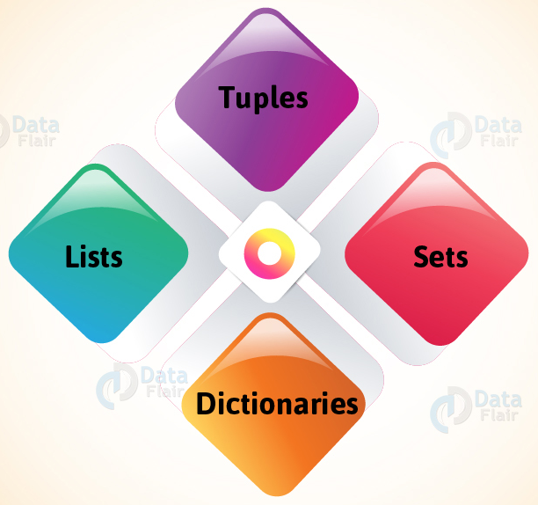
Scripting for beginners
Data Structures

Slide 94
8. List
Contents
Types of List
Characteristics of List
Basic list operations
List Indexing
List Slicing
List Methods
List Built-in functions
List comprehension

Slide 95
Types of List
What is a list ?
A list is a data type that allows you to store various types of data in it.
List is a compound data type which means you can have different data types under a list.
For example we can have integer, float and string items in a same list (homogeneous and heterogeneous).
List elements are enclosed within square braces - []
Types of lists
1. Empty List : empty_list = [ ]
2. Number List : num_list = [10, 20, 15, 35]
3. Float List : float_list = [11.22, 9.9, 78.34, 12.0]
4. String List : string_list = [‘Sun’, ‘Mon’, ‘Tue’, ‘Wed’]
5. Mixed List : mixed_list = [1.13, 2, 5, "Training", 100, "hi"]
6. Nested List : nested_list = [1.13, 2, [5, "Training", 100], "hi"]

Slide 96
Characteristics of List
1. Mutable : A list object can be modified
within the same address space.
>>> a = [1,2,3]
>>> id(a)
1554973203136
>>> a[1]=10
>>> print(a)
[1, 10, 3]
>>> id(a)
1554973203136
>>>
3. Mixed Type Elements :
>>> a = [1,"Hi",20.5]
>>> print(a)
[1, 'Hi', 20.5]
>>>
5. Zero based indexing
>>> a = [10,20,30,40]
>>> a[0]
10
>>> a[1]
20
>>>
4. Variable Length :
>>> a = [1,2,3]
>>> print(a)
[1, 2, 3]
>>> a = [1,2,3,4,5,6]
>>> print(a)
[1, 2, 3, 4, 5, 6]
>>>
6. Nested list :
>>> a = [10,20,[1,2,3],30]
>>> print(a)
[10, 20, [1, 2, 3], 30]
>>> a[2]
[1, 2, 3]
>>>
2. Linear Data Structure : List elements can
be added sequentially
>>> a = [1,2,3]
>>> a = a + [4,5]
>>> print(a)
[1, 2, 3, 4, 5]
>>>

Slide 97
Basic list operations
Operation | Description | Example
Len | Gets length of the list | >>>print(len([10,20,30,40])) 4
Concatenation | Concatenates lists and returns a list | >>>print([10,20]+[15,25]) [10, 20, 15, 25]
Repetition | Repeats the string ‘n’ times and returns a list | >>>print(['Python']*3) ['Python', 'Python', 'Python']
Membership | Checks if the element is present in the list or not | >>>print(3 in [1,2,3]) True >>>print(3 in [1,2,4] False
Iteration | Returns true if a character is present in the given string | >>>for x in [1,2,3]: print(x*x) 1 4 9

Slide 98
List Indexing
Individual characters can be accessed using index.
Positive index starts from 0 from left to right.
Negative indexing starts from -1 from right to left.
s = ['P','Y','T','H','O','N']
print("s[0] : ",s[0])
print("s[1] : ",s[1])
print("s[2] : ",s[2])
print("s[3] : ",s[3])
print("s[4] : ",s[4])
print("s[5] : ",s[5])
print("s[-1] : ",s[-1])
print("s[-2] : ",s[-2])
print("s[-3] : ",s[-3])
print("s[-4] : ",s[-4])
print("s[-5] : ",s[-5])
print("s[-6] : ",s[-6])
Output :
s[0] : P
s[1] : Y
s[2] : T
s[3] : H
s[4] : O
s[5] : N
s[-1] : N
s[-2] : O
s[-3] : H
s[-4] : T
s[-5] : Y
s[-6] : P
>>>
# Print elements in the list using loop
s = [1,2,3,4,5]
for i in s:
print(i)

Slide 99
List Slicing
Lists can be sliced using index.
Positive index starts from 0 from left to right.
Negative indexing starts from -1 from right to left.
Use [Inclusive number : Exclusive number] to slice.
Use [Inclusive : Exclusive : Step] to step and slice.
>>> s = ['P','y','t','h','o','n']
>>> s[1:4]
['y', 't', 'h']
>>>
>>> s = [1,2,3,4,5]
>>> s[-4:-2]
[2, 3]
>>>
>>> s = [10,20,30,[4,5],60,70,80,90]
>>> s[1::2]
[20, [4, 5], 70, 90]
>>>
>>> s[::-2]
[90, 70, [4, 5], 20]
>>> s[3][1]
5
# Deleting List
s = [10,20,30,40,50]
print(s[1:4])
del(s)

Slide 100
List Methods
S.No | List.method() | Description | Example
1 | append() | Add an element to the end of the list (one at a time)
2 | extend() | Add all elements of a list to another list
3 | insert() | Insert an item at the defined index | >>> a = [10,20,30] >>> a.insert(1,40) >>> print(a) [10, 40, 20, 30]
>>> a = [1,2,3]
>>> a.append(4)
>>> print(a)
[1, 2, 3, 4]
>>> a = [1,2,3]
>>> a.append(4,5)
TypeError:
>>> a = [1,2,3]
>>> b = [4,5,6]
>>> a.extend(b)
>>> print(a)
[1, 2, 3, 4, 5, 6]
>>> a = [1,2,3]
>>> b = []
>>> a.extend(b)
>>> print(a)
[1, 2, 3]
>>> a = [10,20,30]
>>> a.insert(15,40)
>>> print(a)
[10, 20, 30, 40]

Slide 101
List Methods
S.No | List.method() | Description | Example
4 | remove() | Removes an item from the list | >>> a = [10,20,30,40] >>> a.remove(30) >>> print(a) [10, 20, 40] >>> a.remove(50) ValueError:
5 | pop() | Removes and returns an element at the given index | >>> a = [10,20,30] >>> a.pop() 30
6 | clear() | Removes all items from the list | >>> a = [10,20,30] >>> a.clear() >>> print(a) []
7 | index() | Returns the index of the first matched item | >>> a = [10,20,30,40] >>> a.index(20) 1

Slide 102
List Methods
S.No | List.method() | Description | Example
8 | count() | Returns the count of number of items passed as an argument | >>> a = [10,20,30,10,40,10,50] >>> a.count(10) 3 >>> a.count(60) 0
9 | sort() | Sort items in a list in ascending order | >>> a = [50,20,40,10,30,10,20] >>> a.sort() >>> print(a) [10, 10, 20, 20, 30, 40, 50]
10 | reverse() | Reverse the order of items in the list | >>> a = [10,20,30,40,50] >>> a.reverse() >>> print(a) [50, 40, 30, 20, 10]
11 | copy() | Returns a shallow copy of the list | >>> a = [1,2,3] >>> b = a # deepcopy >>> c = a.copy() # copy

Slide 103
List Built-in functions
S.No | Function | Description | Example
1 | all() | Return True if all the elements in the list are true | >>> a = [1,0,1] >>> print(all(a)) False
2 | any() | Return True if any element of the list is true | >>> a = [1,0,0,1] >>> print(any(a)) True
3 | enumerate() | Return an enumerate object. It contains the index and value of all the items of the list as tuple. Index starts with zero by default if no value is specified. | >>> a =[11,22,33] >>> print(list(enumerate(a))) [(0, 11), (1, 22), (2, 33)] >>> a = [11,22,33] >>> print(list(enumerate(a,100))) [(100, 11), (101, 22), (102, 33)]
4 | len() | Return the length (number of items) in the list | >>> a = [11,22,33,44] >>> print(len(a)) 4

Slide 104
List Built-in functions
S.No | Function | Description | Example
5 | list() | Convert an iterable (tuple, string, set, dictionary) to a list | >>> s = "abcdef" >>> print(list(s)) ['a', 'b', 'c', 'd', 'e', 'f']
6 | max() | Return the largest number in the list | >>> a = [11,4,22,35,2,-3,5,-1] >>> print(max(a)) 35
7 | min() | Return the smallest number in the list | >>> a = [11,4,22,35,2,-3,5,-1] >>> print(min(a)) -3
8 | sum() | Return the sum of all elements in the list | >>> a = [11,4,22,35,2,-3,5,-1] >>> print(sum(a)) 75

Slide 105
List comprehension
new_list = [expression for member in iterable]
Ex : squares = [i * i for i in range(10)]
Every list comprehension in Python includes three elements:
expression is the member itself, a call to a method, or any other valid expression that returns a value.
member is the object or value in the list or iterable.
iterable is a list, set, sequence, generator, or any other object that can return its elements one at a time.
Example 1:
>>> sentence = 'the rocket came back from mars'
>>> vowels = [i for i in sentence if i in 'aeiou']
>>> vowels
['e', 'o', 'e', 'a', 'e', 'a', 'o', 'a']

Slide 106
List comprehension
Example 2 :
>>> original_prices = [1.25, -9.45, 10.22, 3.78, -5.92, 1.16]
>>> prices = [i if i > 0 else 0 for i in original_prices]
>>> prices
[1.25, 0, 10.22, 3.78, 0, 1.16]
Example 4 :
result = []
for x in range(3):
for y in range(3):
result.append((x, y,))
result
This is same as
result = [(x, y,) for x in range(3) for y in range(3)]
Example 3 :
>>> original_prices = [1.25, -9.45, 10.22, 3.78, -5.92, 1.16]
>>> def get_price(price):
return price if price > 0 else 0
>>> prices = [get_price(i) for i in original_prices]
>>> prices
[1.25, 0, 10.22, 3.78, 0, 1.16]

Slide 107
9. Tuple
Contents
What is Tuple?
Packing/Unpacking, SIngleton Tuple
Characteristics
Tuple Indexing
Tuple Slicing
Basic tuple operations
Tuple Methods
Tuple Built-in functions

Slide 108
What is tuple?
Tuple is an ordered collection and allows duplicate elements like list.
Allows to store heterogeneous elements
Tuple elements are enclosed within braces or paranthesis - ()
A tuple with only one element should have a comma after the element, else it will taken as int object.
List and Tuple - comparision
List is Mutable where as tuple is immutable.
Both are ordered and allows duplicate elements.
Both support indexing and slicing.
Advantages of Tuple over List
We generally use tuples for heterogeneous (different) data types and lists for homogeneous (similar) data types.
Since tuples are immutable, iterating through a tuple is faster than with list. So there is a slight performance boost.
Tuples that contain immutable elements can be used as a key for a dictionary. With lists, this is not possible.
If you have data that doesn't change, implementing it as tuple will guarantee that it remains write-protected.

Slide 109
Packing, Singleton tuple
Tuple packing and unpacking :
Multiple values can be assigned to multiple
variables using tuple.
Singleton tuple :
Tuple with single element is called singleton tuple.
>>> a = (10)
>>> type(a)
<class 'int'>
>>> a = (10,)
>>> type(a)
<class 'tuple'>
>>> tup = 10, 34.56, "Python", 10
>>> a,b,c,d = tup
>>> print(a)
10
>>> print(b)
34.56
>>> print(c)
Python
>>> print(d)
10
>>> print(tup)
(10, 34.56, 'Python', 10)
>>>

Slide 110
Types
Like list, tuple can have below values.
1. Empty Tuple : empty_tup = ()
2. Number Tuple : num_tup = (10, 20, 15, 35)
3. Float Tuple : float_tup = (11.22, 9.9, 78.34, 12.0)
4. String Tuple : string_tup = ('Sun', 'Mon', 'Tue', 'Wed')
5. Mixed Tuple : mixed_tup = (1.13, 2, 5, "Training", 100, "hi")
6. Nested Tuple : nested_tup = (1.13, 2, [5, "Training", 100], "hi")
nested_tup = (1.13, 2, (5, "Training", 100), "hi")

Slide 111
Characteristics of Tuple
1. Linear Data Structure :
>>> a = (1,2,3)
>>> a = a + (4,5)
>>> print(a)
(1, 2, 3, 4, 5)
>>>
3. Zero based indexing :
>>> a = (10,20,30,40)
>>> a[0]
10
>>> a[1]
20
>>>
5. Mutable :
>>> a = (1,2,3)
>>> a[1]=10
TypeError:
2. Variable Length :
>>> a = (1,2,3)
>>> print(a)
(1, 2, 3)
>>> a = (1,2,3,4,5,6)
>>> print(a)
(1, 2, 3, 4, 5, 6)
>>>
4. Nested list :
>>> a = (10,20,[1,2,3],30)
>>> print(a)
(10, 20, [1, 2, 3], 30)
>>> a[2]
[1, 2, 3]
>>>

Slide 112
Tuple Indexing
Individual characters can be accessed using index.
Positive index starts from 0 from left to right.
Negative indexing starts from -1 from right to left.
s = ('P','Y','T','H','O','N')
print("s[0] : ",s[0])
print("s[1] : ",s[1])
print("s[2] : ",s[2])
print("s[3] : ",s[3])
print("s[4] : ",s[4])
print("s[5] : ",s[5])
print("s[-1] : ",s[-1])
print("s[-2] : ",s[-2])
print("s[-3] : ",s[-3])
print("s[-4] : ",s[-4])
print("s[-5] : ",s[-5])
print("s[-6] : ",s[-6])
Output :
s[0] : P
s[1] : Y
s[2] : T
s[3] : H
s[4] : O
s[5] : N
s[-1] : N
s[-2] : O
s[-3] : H
s[-4] : T
s[-5] : Y
s[-6] : P
>>>
# Print elements in the tuple using loop
>>> s = (1,2,3,4,5)
>>> for i in s:
print(i)

Slide 113
Tuple Slicing
Tuples can be sliced using index.
Positive index starts from 0 from left to right.
Negative indexing starts from -1 from right to left.
Use [Inclusive number : Exclusive number] to slice.
Use [Inclusive : Exclusive : Step] to step and slice.
>>> s = ('P','y','t','h','o','n')
>>> s[1:4]
('y', 't', 'h')
>>>
>>> s = (1,2,3,4,5)
>>> s[-4:-2]
(2, 3)
>>>
>>> s = (10,20,30,[4,5],60,70,80,90)
>>> s[1::2]
(20, [4, 5], 70, 90)
>>>
>>> s[::-2]
(90, 70, [4, 5], 20)
>>> s[3][1]
5
>>>
# Deleting Tuple
s = (10,20,30,40,50)
print(s[1:4])
del(s)

Slide 114
Basic Tuple operations
Operation | Description | Example
Len | Gets length of Tuple | >>> a = (10,20,30,40) >>> print(len(a)) 4
Concatenation | Concatenates lists and returns a list | >>> print((10,20)+(15,25)) (10, 20, 15, 25) >>>
Repetition | Repeats the string ‘n’ times and returns a string | >>> print(('Python')*3) PythonPythonPython >>>
Membership | Checks if the element is present in the tuple or not | >>> print(3 in (1,2,3)) True >>> print(3 in (1,2,4)) False
Iteration | Returns true if a character is present in the given string | >>>for x in (1,2,3): print(x*x) 1 4 9

Slide 115
Tuple Methods
S.No | Tuple.method() | Description | Example
1 | count() | Returns the count of number of items passed as an argument | >>> a = (10,10,20,10,30) >>> print(a.count(10)) 3 >>> print(a.count(25)) 0 >>>
2 | index() | Gets the index of the element if present | >>> a = (10,10,20,10,30) >>> print(a.index(30)) 4 >>> print(a.index(10)) 0 >>> print(a.index(25)) ValueError:

Slide 116
Tuple Built-in functions
S.No | Function | Description | Example
1 | all() | Return True if all the elements in the tuple are true | >>> a = (1,0,1) >>> print(all(a)) False
2 | any() | Return True if any element of the list is true | >>> a = (1,0,0,1) >>> print(any(a)) True
3 | enumerate() | Return an enumerate object. It contains the index and value of all the items of the list as tuple. Index starts with zero by default if no value is specified. | >>> a =(11,22,33) >>> print(list(enumerate(a))) [(0, 11), (1, 22), (2, 33)] >>> a = (11,22,33) >>> print(list(enumerate(a,100))) [(100, 11), (101, 22), (102, 33)]
4 | len() | Return the length (number of items) in the list | >>> a = (11,22,33,44) >>> print(len(a)) 4

Slide 117
Tuple Built-in functions(contd)
S.No | Function | Description | Example
5 | list() | Convert an iterable (tuple, string, set, dictionary) to a list | >>> s = "abcdef" >>> print(tuple(s)) ('a', 'b', 'c', 'd', 'e', 'f') >>>
6 | max() | Return the largest number in the list | >>> a = (11,4,22,35,2,-3,5,-1) >>> print(max(a)) 35
7 | min() | Return the smallest number in the list | >>> a = (11,4,22,35,2,-3,5,-1) >>> print(min(a)) -3
8 | sum() | Return the sum of all elements in the list | >>> a = (11,4,22,35,2,-3,5,-1) >>> print(sum(a)) 75

Slide 118
10. Set
Contents
What is a Set?
Characteristics of Sets
Basic Set operations
Set Methods
Set Built-in functions
Frozen Set

Slide 119
What is a Set ?
A set is an unordered collection of items.
Every set element is unique (no duplicate elements are allowed).
A set itself may be modified, but the elements contained in the set must be of an immutable type.
Sets can also be used to perform mathematical set operations like union, intersection, symmetric difference, etc.
>>> a = {}
>>> type(a)
<class 'dict'>
>>> a = {0}
>>> type(a)
<class 'set'>
>>> a = set()
>>> type(a)
<class 'set'>
A set is created by placing all the items (elements) inside curly braces {}
An empty set is considered as a dictionary.
So declare a set with atleast one element or use set() function to create one.

Slide 120
Set Characteristics
1. An empty set is falsy in a Boolean context:
>>> x = set()
>>> bool(x)
False
2. It can have any number of items and they may be of different types.
>>> x = {42, 'Hello', 3.14159, None}
3. Set elements must be immutable.
>>> x = {42, 'Hello', (1,2,3), None} # allowed as tuple is immutable
>>> x = {42, 'Hello', [1,2,3], None} # Gives Type Error

Slide 121
Set Basic operations
2. Other Operations:
If x and y are two different sets,
x | y return the set of all elements in either x or y.
x & y return the set of elements common to both x and y.
x - y return the set of all elements that are in x but not in y
x ^ y return the set of all elements in either x or y
x <= y return True if x is a subset of y
x >= y return True if x is a superset of y
3. Modifying sets:
x1 |= x2 add to x1 any elements in x2 that x1 does not already have
x1 &= x2 update x, retaining only elements found in both x and y
x -= y update x, removing elements found in y
x ^= y update x, retaining elements found in either x or y, but not both
1. Membership operator
>>> x = {42, 'Hello', (1,2,3), None}
>>> 'Hello' in x
True
>>> 24 in x
False

Slide 122
Set Methods
S.No | Method | Description | Example
1 | add() | Adds an element to the set. Element can get added at any index as set is unordered. | >>> s = {"C", "C++", "Java"} >>> s.add("Python") >>> print(s) {'Python', 'C', 'C++', 'Java'}
2 | clear() | Removes all the elements from the set | >>> s = {"C", "C++", "Java"} >>> s.add("Python") >>> print(s) set()
3 | copy() | Returns a copy of the set (shallow copy) | >>> s = {"C","C++","Python"} >>> a = s.copy() >>> print(a) {'Python', 'C', 'C++'} >>> s.add("Java") >>> print(s) {'Python', 'C', 'C++', 'Java'} >>> print(a) {'Python', 'C', 'C++'}

Slide 123
Set Methods
S.No | Method | Description | Example
4 | difference() | Returns a set containing the difference between two or more sets. a.difference(b,c) is same as a - b - c | >>> b = s.difference(a) # same as s-a >>> print(b) {'Java'}
5 | difference_update() | Removes the items in this set that are also included in another, specified set. Same as s -= x | >>> b = s.difference_update(a) >>> print(b) None >>> print(s) {'Java'} >>> print(a) {'Python', 'C', 'C++'}
6 | discard() | Remove the specified item | >>> b = s.discard("Java") >>> print(b) None >>> print(s) set()

Slide 124
Set Methods
S.No | Method | Description | Example
7 | intersection() | Returns a set, that is the intersection of two other sets | >>> x = {"C", "C++", "Java"} >>> y = {"Python", "C++", "C"} >>> z = x.intersection(y) >>> print(z) {'C', 'C++'}
8 | intersection_update() | Removes the items in this set that are not present in other, specified set(s). Same as x &= y | >>> z = x.intersection_update(y) >>> print(z) None >>> print(x) {'C', 'C++'} >>> print(y) {'Python', 'C++', 'C'}
9 | isdisjoint() | Returns whether two sets have a intersection or not | >>> z = x.isdisjoint(y) >>> print(z) False

Slide 125
Set Methods
S.No | Method | Description | Example
10 | issubset() | Returns whether another set contains this set or not. Same as x <= y | >>> z = x.issubset(y) >>> print(z) True
11 | issuperset() | Returns whether this set contains another set or not. Same as y >= x | >>> z = y.issuperset(x) >>> print(z) True
12 | pop() | Removes an element from the set | >>> z = y.pop() >>> print(z) Python
13 | remove() | Removes the specified element | >>> z = y.remove("C") >>> print(z) None >>> print(y) {'C++'}

Slide 126
Set Methods
S.No | Method | Description | Example
14 | symmetric_difference() | Returns a set with the symmetric differences of two sets. same as x ^ y | >>> x = {"C", "C++", "Java"} >>> y = {"Python", "C++", "C"} >>> z = x.symmetric_difference(y) >>> print(z) {'Python', 'Java'}
15 | symmetric_difference_update() | inserts the symmetric differences from this set and another. Same as x ^= y | >>> z = x.symmetric_difference_update(y) >>> print(x) {'Python', 'Java'}
16 | union() | Return a set containing the union of sets | >>> z = x.union(y) # same as x | y >>> print(z) {'C', 'C++', 'Python', 'Java'}
17 | update() | Update the set with another set, or any other iterable. Same as y |= x | >>> z = y.update(x) >>> print(y) {'C', 'Python', 'C++', 'Java'}

Slide 127
Set Built-in functions
S.No | Function | Description | Example
1 | all() | Return True if all the elements in the tuple are true | >>> s = {10,20,11,9,3,7,-1} >>> all(s) True
2 | any() | Return True if any element of the list is true | >>> s = {10,20,11,9,3,7,-1} >>> any(s) True
3 | enumerate() | Return an enumerate object. It contains the index and value of all the items of the list as tuple. Index starts with zero by default if no value is specified. | >>> s = {10,20,11,9,3,7,-1} >>> enumerate(s) >>> for i in x: print(i,end="") (0, 3)(1, 7)(2, 9)(3, 10)(4, 11)(5, 20)(6, -1)
4 | len() | Return the length (number of items) in the list | >>> s = {10,20,11,9,3,7,-1} >>> len(s) 7

Slide 128
Set Built-in functions(contd)
S.No | Function | Description | Example
5 | list() | Convert an iterable (tuple, string, set, dictionary) to a list | >>> s = {10,20,11,9,3,7,-1} >>> list(s) [3, 7, 9, 10, 11, 20, -1]
6 | max() | Return the largest number in the list | >>> s = {10,20,11,9,3,7,-1} >>> max(s) 20
7 | min() | Return the smallest number in the list | >>> s = {10,20,11,9,3,7,-1} >>> min(s) -1
8 | sum() | Return the sum of all elements in the list | >>> s = {10,20,11,9,3,7,-1} >>> sum(s) 59

Slide 129
Frozen Set
Python provides another built-in type called a frozenset, which is in all respects exactly like a set, except that a frozenset is immutable. You can perform non-modifying operations on a frozenset:
>>> x = {"abc", "pqr", "mno"}
>>> x
{'abc', 'pqr', 'mno'}
>>> x = frozenset({"abc", "pqr", "mno"})
>>> x
frozenset({'abc', 'pqr', 'mno'})
>>> y = {"AZ"}
>>> x.update(y)
Traceback (most recent call last):
File "<pyshell#44>", line 1, in <module>
x.update(y)
AttributeError: 'frozenset' object has no attribute 'update'
>>>

Slide 130
Frozen Set
Sets are mutable
(cannot be used as keys to dictionary)
>>> x = {"A","B","C"}
>>> y = x
>>> id(y)
1904353239328
>>> y |= {"a","b","c"}
>>> y
{'C', 'c', 'b', 'A', 'a', 'B'}
>>> id(y)
1904353239328
>>> x
{'C', 'c', 'b', 'A', 'a', 'B'}
>>> id(x)
1904353239328
>>>
Frozen sets are immutable
(can be used as keys to dictionary)
>>> x = frozenset({"A","B","C"})
>>> y = x
>>> id(y)
1904353241120
>>> y |= {"a","b","c"}
>>> y
frozenset({'C', 'b', 'A', 'a', 'B', 'c'})
>>> id(y)
1904353239552
>>> x
frozenset({'B', 'C', 'A'})
>>> id(x)
1904353241120
>>>

Slide 131
11. Dictionary
Contents
What is a Dictionary?
Types of Dictionaries
Characteristics of Dictionary
Dictionary Methods

Slide 132
What is a dictionary?
A dictionary in Python programming language is an unordered collection of data values such as a map.
Dictionary holds key:value pair.
It helps in defining a one-to-one relationship between keys and values.
Values in a dictionary can be of any datatype and can be duplicated, whereas keys can’t be repeated and must be immutable.
Dictionary keys are case sensitive, same name but different cases of Key will be treated distinctly.
Dictionaries are optimized to retrieve values when the key is known.
Like Sets, Dictionary elements are enclosed within flower braces - {}
An empty set is considered as a dictionary.
dict() function can be used to create a dictionary.

Slide 133
Types of Dictionary
Empty dictionary declaration : my_dict = {} or my_dict = dict({})
Dictionary with one element : >>> my_dict = {"A" : "Apple"}
Dictionary with mixed Key-value pairs : >>> my_dict = {"A" : "Apple", 1 : "One", "two" : 2, 3 : [1,2,3]}
Nested Dictionary : >>> my_dict = {1: 'Hello', 2: 'World', 3: {'A': 'Python', 'B': 'is', 'C': 'fun'}}

Slide 134
Characteristics of Dictionary
1. Dictionaries cannot have two items with the same key:
>>> my_dict = {"A" : "Apple", "A" : "Aircraft"}
>>> print(my_dict)
{'A': 'Aircraft'}
>>>
4. Items can be added using key as index.
>>> my_dict = {"A":"Ant", "B":"Bat"}
>>> my_dict["C"] = "Cat"
>>> print(my_dict)
{'A': 'Ant', 'B': 'Bat', 'C': 'Cat'}
2. Dictionary keys are case sensitive.
>>> my_dict = {"A" : "Apple", "a" : "Aircraft"}
>>> print(my_dict)
{'A': 'Apple', 'a': 'Aircraft'}
>>>
5. Items can be modified using key as index.
>>> my_dict = {"A":"Ant", "B":"Bat"}
>>> my_dict["B"] = "Boll"
>>> print(my_dict)
{'A': 'Ant', 'B': 'Boll'}
3. Dictionaries cannot have mutable elements as keys.
>>> my_dict = {[1,2,3] : "list"}
TypeError: unhashable type: 'list'

Slide 135
Dictionary Methods
S.No | Method | Description | Example
1 | clear() | Removes all items from the dictionary. | >>> d = {1 : "one"} >>> print(d) {1: 'one'} >>> d.clear() >>> print(d) {}
2 | copy() | Returns a shallow copy of the dictionary. | >>> d = {1 : "one"} >>> x = d.copy() >>> print(x) {1: 'one'}
3 | fromkeys(seq[, v]) | Returns a new dictionary with keys from seq and value equal to v (defaults to None). | >>> d = {1:"one",2:"two",3:"three"} >>> x = dict.fromkeys(d) >>> print(x) {1: None, 2: None, 3: None} >>>

Slide 136
Dictionary Methods
S.No | Method | Description | Example
4 | get(key[,d]) | Returns the value of the key. If the key does not exist, returns d (defaults to None). | >>> d = {'A': 'Ant', 'B': 'Bat', 'C': 'Cat'} >>> x = d.get('B') >>> print(x) Bat
5 | items() | Return a new object of the dictionary's items in (key, value) format. | >>> d {'A': 'Ant', 'B': 'Bat', 'C': 'Cat'} >>> x = d.items() >>> x dict_items([('A', 'Ant'), ('B', 'Bat'), ('C', 'Cat')])
6 | keys() | Returns a new object of the dictionary's keys. | >>> d {'A': 'Ant', 'B': 'Bat', 'C': 'Cat'} >>> x = d.keys() >>> x dict_keys(['A', 'B', 'C'])

Slide 137
Dictionary Methods
S.No | Method | Description | Example
7 | pop(key[,d]) | Removes the item with the key and returns its value or d if key is not found. If d is not provided and the key is not found, it raises KeyError. | >>> d {'A': 'Ant', 'B': 'Bat', 'C': 'Cat'} >>> x = d.pop('B') >>> x 'Bat'
8 | popitem() | Removes and returns an arbitrary item (key, value). Raises KeyError if the dictionary is empty. | >>> d {'A': 'Ant', 'B': 'Bat', 'C': 'Cat'} >>> d.popitem() ('C', 'Cat')
9 | setdefault(key[,d]) | Returns the corresponding value if the key is in the dictionary. If not, inserts the key with a value of d and returns d (defaults to None). | >>> d {'A': 'Ant'} >>> x = d.setdefault('B',"Bat") >>> d {'A': 'Ant', 'B': 'Bat'} >>> x 'Bat'

Slide 138
Dictionary Methods
S.No | Method | Description | Example
10 | update([other]) | Updates the dictionary with the key/value pairs from other, overwriting existing keys. | >>> d {'A': 'Ant', 'B': 'Bat'} >>> x = {'C':'Cat'} >>> x {'C': 'Cat'} >>> d.update(x) >>> d {'A': 'Ant', 'B': 'Bat', 'C': 'Cat'} >>>
11 | values() | Returns a new object of the dictionary's values | >>> d {'A': 'Ant', 'B': 'Bat'} >>> d.values() dict_values(['Ant', 'Bat'])

Slide 139
12. Errors
Contents
Types of Errors
Common run time errors
Examples

Slide 140
Types of Errors
1. Syntax errors
2. Logical errors or Semantic errors
3. Run time errors
print(Hello World”)
print(“Hello’)
class = “Python”
name = “Python
>>> x=3
>>> y=4
>>> avg = 3+4/2
>>> print(avg)
5.0
>>> avg = (3+4)/2
>>> print(avg)
3.5
xyz = 200
print(xy)
# compileall
How to avoid Syntax Errors?
Never use a python keyword for a variable name
2. Any strings in the code should have matching quotation marks
3. Always check unclosed opening operators – (,{,[
4. Always check the indentation
5. Don’t give your module the same name as one of the
standard python modules

Slide 141
Common Run time Errors
Exception | Cause
KeyError | Raised when a key is not found in a dictionary.
ImportError | Raised when the imported module is not found.
NameError | Raised when a variable is not found in local or global scope.
IndexError | Raised when the index of a sequence is out of range.
SyntaxError | Raised by parser when syntax error is encountered.

Slide 142
Examples
KeyError | Raised when a key is not found in a dictionary.
>>> dic = {1:10, 2:20, 3:30}
>>> dic[3]
30
>>> dic[4]
Traceback (most recent call last):
File "<pyshell#29>", line 1, in <module>
dic[4]
KeyError: 4
>>> dic[-2]
Traceback (most recent call last):
File "<pyshell#30>", line 1, in <module>
dic[-2]
KeyError: -2

Slide 143
Examples
ImportError | Raised when the imported module is not found.
>>> import regex
Traceback (most recent call last):
File "<pyshell#33>", line 1, in <module>
import regex
ModuleNotFoundError: No module named 'regex'

Slide 144
Examples
IndexError | Raised when the index of a sequence is out of range.
>>> list = [10,20,30]
>>> print(list[5])
Traceback (most recent call last):
File "<pyshell#16>", line 1, in <module>
print(list[5])
IndexError: list index out of range
>>> list = [40,50,60]
>>> print(list[-4])
Traceback (most recent call last):
File "<pyshell#19>", line 1, in <module>
print(list[-4])
IndexError: list index out of range

Slide 145
Examples
NameError | Raised when a variable is not found in local or global scope.
def fun():
print("Hello World")
func()
Traceback (most recent call last):
File "<pyshell#14>", line 1, in <module>
func()
NameError: name 'func' is not defined
>>> xyz=100
>>> print(xy)
Traceback (most recent call last):
File "<pyshell#9>", line 1, in <module>
print(xy)
NameError: name 'xy' is not defined
>>>

Slide 146
Examples
ZeroDivisionError | Raised when the second operand of division or modulo operation is zero.
>>> 0/0
Traceback (most recent call last):
File "<pyshell#24>", line 1, in <module>
0/0
ZeroDivisionError: division by zero
>>> 1/0.0
Traceback (most recent call last):
File "<pyshell#26>", line 1, in <module>
1/0.0
ZeroDivisionError: float division by zero
>>> 1/False
Traceback (most recent call last):
File "<pyshell#29>", line 1, in <module>
1/False
ZeroDivisionError: division by zero

Slide 147
Examples
>>> ord(1)
Traceback (most recent call last):
File "<pyshell#125>", line 1, in <module>
ord(1)
TypeError: ord() expected string of length 1, but int found
>>> ord('a')
97
>>> chr(2007496528)
Traceback (most recent call last):
File "<pyshell#127>", line 1, in <module>
chr(2007496528)
ValueError: chr() arg not in range(0x110000)

Slide 148
13. Packages
Contents
What is a Package?
Example without package
Example with package
Creating Multiple packages
Renaming a package
Reloading a package
Creating a sub package
Examples

Slide 149
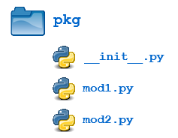
What is a Package?
Package is like a directory.
It is a hierarchical file directory structure that defines a single python application environment which consists of modules and sub packages and so on..
The main idea is to divide the code base into clean, efficient modules using python packages.
As our application program grows larger in size with a lot of modules, we place similar modules in one package and import them when required.
This makes the project easy to manage and conceptually clear.
Similarly, as a directory can contain subdirectories and files, a Python package can have
sub-packages and modules.
A directory must contain a file named __init__.py in order for Python to consider it as a package.
This file can be left empty but we generally place the initialization code for that package in this file.

Slide 150
Built-in Packages
S.No | Package Name | Description
1 | argparse | Command‐line option and argument-parsing library.
2 | array | Space‐effi cient arrays of uniformly typed numeric values.
3 | audioop | Manipulate raw audio data.
4 | calendar | Functions for working with calendars
5 | cmath | Mathematical functions for complex numbers.
6 | cmd | Build line‐oriented command interpreters.
7 | code | Facilities to implement read‐eval‐print loops.
8 | codecs | Encode and decode data and streams.
9 | collections | Container data types.
10 | colorsys | Conversion functions between RGB and other color systems
11 | compileall | Tools for byte‐compiling all Python source fi les in a directory tree or some subset thereof.
12 | concurrent | Execute computations concurrently using threads or processes.

Slide 151
Built-in Packages
S.No | Package Name | Description
13 | copy | Shallow and deep copy operations
14 | csv | Write and read tabular data to and from comma‐delimited data files
15 | ctypes | A foreign function library for Python.
16 | datetime | Basic date and time types.
17 | e-mail | Package supporting the parsing, manipulating, and generating of e‐mail messages, including MIME documents
18 | encodings | Package supporting various character encodings.
19 | enum | Implementation of an enumeration class.
20 | errno | Standard errno system symbols.
21 | fcntl (UNIX) | The fcntl() and ioctl() system calls
22 | filecmp | Compare files efficiently.
23 | fileinput | Loop over standard input or a list of files.
24 | fractions | Rational numbers

Slide 152
Built-in Packages
S.No | Package Name | Description
25 | functools | Higher‐order functions and operations on callable objects.
26 | html.parser | A simple parser that can handle HTML and XHTML
27 | http | Package supporting use of HTTP including client, server, and cookie management.
28 | keyword | Test whether a given string is a Python keyword.
29 | logging | Flexible event logging for applications
30 | math | Mathematical functions
31 | mimetypes | Mapping of fi lename extensions to MIME types.
32 | multiprocessing | Package for process‐based parallelism.
33 | os | Miscellaneous operating system interfaces
34 | os.path | Provides helper functions for manipulating and testing fi le paths.
35 | pdb | A debugger for interactive Python interpreters
36 | queue | A queue class suitable for communicating between threads

Slide 153
Built-in Packages
S.No | Package Name | Description
37 | re | Regular‐expression operations.
38 | sched | General‐purpose event scheduler
39 | shutil | High‐level fi le operations, including copying.
40 | signal | Set handlers for asynchronous events.
41 | smtpd | An SMTP server implementation in Python
42 | smtplib | SMTP protocol client (requires sockets).
43 | socket | Low‐level networking interface
44 | string | Common string operations.
45 | sys | Access system‐specific parameters and functions.
46 | sysconfig | Python’s confi guration information
47 | syslog (UNIX) | An interface to the UNIX syslog library routines
48 | threading | Parallel processing based on threads.

Slide 154
Built-in Packages
S.No | Package Name | Description
49 | time | Time access and conversions.
50 | tkinter | Interface to Tcl/Tk for graphical user interfaces.
51 | tty (UNIX) | Utility functions that perform common terminal control operations.
52 | turtle | An educational framework for developing simple graphics applications.
53 | types | Names for Python’s built‐in types.
54 | xml | Package containing XML processing modules
55 | zipfile | Read and write zip‐format archive files.
56 | pillow | Python Imaging Library
57 | pandas | Process time-series data or perform statistical analysis on a data set
https://onlinelibrary.wiley.com/doi/pdf/10.1002/9781119207580.app2

Slide 155
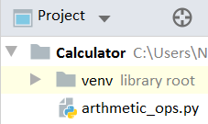
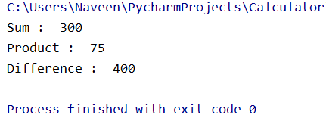
Example without package
arthmetic_op.py
def add(x,y):
print("Sum : ", x+y)
return
def mul(x,y):
print("Product : ", x*y)
return
def sub(x,y):
print("Difference : ", x-y)
return
def test_calc():
add(100,200)
mul(15,5)
sub(500,100)
return
test_calc()

Slide 156
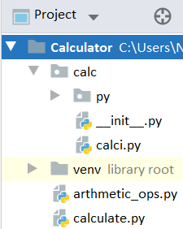
Example with user defined Package
Python from...import statement
calc -> calci.py
calculate.py
def add(x,y):
print("Sum : ", x+y)
return
def mul(x,y):
print("Product : ", x*y)
return
def sub(x,y):
print("Difference : ", x-y)
return
from calc import calci
# from calc import *
def test_calc():
calci.add(100,200)
calci.mul(15,5)
calci.sub(500,100)
if __name__ == '__main__':
test_calc()

Slide 157
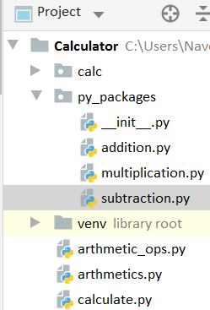
Creating Multiple packages
# addition.py
def add(x,y): print("Sum : ", x+y) return
arthmetics.py
from py_packages import addition, subtraction, multiplication
def test_calc(): addition.add(100,200) multiplication.mul(15,5) subtraction.sub(500,100)
if __name__ == '__main__': test_calc()
# multiplication.py
def mul(x,y): print("Product : ", x*y) return
# subtraction.py
def sub(x,y): print("Difference : ", x-y) return

Slide 158
Renaming a package
from py_packages import addition, subtraction, multiplication
def test_calc(): addition.add(100,200) multiplication.mul(15,5) subtraction.sub(500,100)
Import with renaming
from py_packages import addition as a, subtraction as s, multiplication as m
def test_calc(): a.add(100,200) m.mul(15,5) s.sub(600,100)

Slide 159
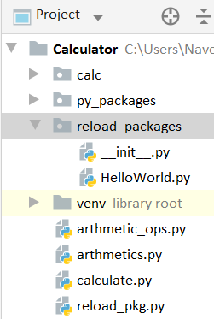
Reloading a package
HelloWorld.py
def func(): print("Hello World") return
from reload_packages import HelloWorld import time # In built Package import importlib def try_reload(): HelloWorld.func() print("\nsleep(10)") time.sleep(10) HelloWorld.func() print("\nsleep(20) Before reload") time.sleep(20) importlib.reload(HelloWorld) HelloWorld.func() if __name__ == '__main__': try_reload()

Slide 160
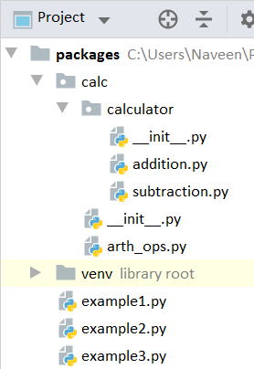
Creating a sub package
arth_ops.py
def add(a,b): print("Add ",a+b) return def sub(a,b): print("Sub ", b-a) return
example1.py
from calc.calculator import addition, subtraction
from calc import arth_ops def test_func(): addition.sum(10,20) subtraction.difference(15,30) arth_ops.add(2,3) arth_ops.sub(7,8) if __name__ == '__main__': test_func()
addition.py
def sum(a,b): print("Sum ",a+b) return
subtraction.py
def difference(a,b): print("Difference ",b-a) return

Slide 161
Examples
Creating sub packages – Ex2
arth_ops.py
def add(a,b): print("Add ",a+b) return def sub(a,b): print("Sub ", b-a) return
example2.py
from calc.calculator import addition, subtraction
from calc.arth_ops import * def test_func(): addition.sum(10,20) subtraction.difference(15,30) add(2,3) sub(7,8) if __name__ == '__main__': test_func()
addition.py
def sum(a,b): print("Sum ",a+b) return
subtraction.py
def difference(a,b): print("Difference ",b-a) return

Slide 162
Examples
Creating sub packages – Ex3
arth_ops.py
def add(a,b): print("Add ",a+b) return def sub(a,b): print("Sub ", b-a) return
from calc.calculator.addition import * from calc.calculator.subtraction import * from calc.arth_ops import * def test_func(): sum(10,20) difference(15,30) add(2,5) sub(7,8) if __name__ == '__main__': test_func()
addition.py
def sum(a,b): print("Sum ",a+b) return
subtraction.py
def difference(a,b): print("Difference ",b-a) return

Slide 163
Examples
Creating sub packages – Ambiguity
(Namespace)
arth_ops.py
def add(a,b): print("Add ",a+b) return def sub(a,b): print("Sub ", b-a) return
from calc.calculator.addition import * from calc.calculator.subtraction import * from calc.arth_ops import * def test_func(): add(10,20) # sum difference(15,30) add(2,5) sub(7,8) if __name__ == '__main__': test_func()
addition.py
def add(a,b): #sum print("Sum ",a+b) return
subtraction.py
def difference(a,b): print("Difference ",b-a) return

Slide 164
14. Regex

Slide 165

We can test whether two strings are equal using the equality (==) operator.
line1 = "We are in python session" line2 = "We are in python session"
if line1 == line2: print(“Same") else: print(“Different")

Slide 166
We can test whether one string is a substring of another with the in operator or
the built-in string methods .find() and .index().
line1 = "We are in python session" line2 = "We are in perl session"
if line1 in line2: print("Same") else: print("Different")
line1 = "We are in python session" line2 = "python"
print(line1.find(line2))
line1 = "We are in python session" line2 = "python"
print(line1.index(line2))

Slide 167
In these examples, the matching is done by a straightforward character-by-character comparison.
s = "1a2b3c4D" r = "5e6f7g8H"
3 consecutive numbers ending with an upper case character?
Regular expressions are powerful standardized way of searching, replacing and parsing text
with complex patterns of characters - programming with characters.
These are also used to check whether the given data is in correct format or not.
Python provides build-in-functions to work with regular expressions easily -
import re

Slide 168
Ken Thompson, known for the design and implementation of Unix included support
for these regular expressions in his version of QED.
To search with a regular expression in QED, the following had to be written:
g/<regular expression>/p
In the preceding line of code, g means global search and p means print.
If, instead of writing regular expression, we write the short form re, we get g/re/p,
and therefore, the beginnings of the venerable UNIX command-line tool grep.

Slide 169
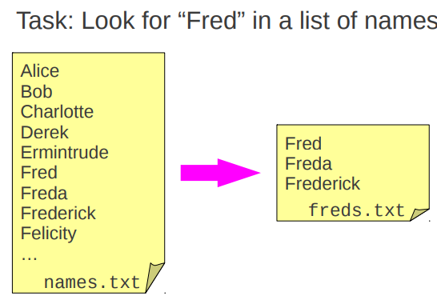
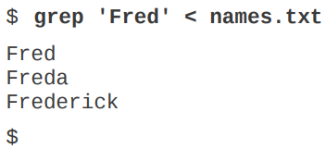

Slide 170
Any experienced developer has undoubtedly used some kind of regular expression.
For instance, in the operating system console, it's not uncommon to find the usage
of the asterisk (*) or the question mark (?) to find files.
file?.xml
file1.xml
file2.xml
file99.xml
file*.xml
files.xml
filename.xml
file_dup.xml
file123.xml
Two kind of components: literals (file and .xml) and metacharacters (? or *).

Slide 171
Literals
Literals are the simplest form of pattern matching in regular expressions.
They will simply succeed whenever that literal is found.
“The quick brown fox jumps over the lazy dog” /fox/ -> one result
“To be, or not to be” /be/ -> gives 2 results
“this is outside (this is inside)” /this is inside/ -> ignores parenthesis
We can use metacharacters as if they were literals.
Escape the metacharacters by preceding them with a backslash.
use the re.escape method to escape non-alphanumeric characters that may
appear in the expression

Slide 172
The most common uses of regular expressions are:
1. Search a string (search and match)
2. Finding a string (findall)
3. Break string into a sub strings (split)
4. Replace part of a string (sub)
import re
re.sub() re.search() re.match() re.fullmatch() re.compile() re.escape() re.findall() re.finditer() re.purge() re.split() re.subn() re.template()
The ‘re’ package provides multiple methods to perform queries on an input string.

Slide 173
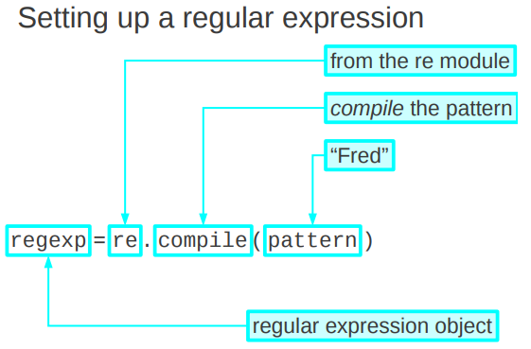
re.compile(pattern, flags=0)
Compile a regular expression pattern into a regular expression object,
which can be used for matching using its match() and search() methods

Slide 174
re.compile()
import re
text_to_search = "abcdefghijklmnopqrstuvwxyz"
pattern = re.compile(r'abc')
res = re.match(pattern, text_to_search)
print(res)
print(type(pattern))
print(pattern)
<re.Match object; span=(0, 3), match='abc'>
<class 're.Pattern'>
re.compile('abc')
## try re.compile(r'\tabc')
## print(text_to_search[0:3])

Slide 175
re.match()
re.match(pattern, string, flags=0)
This method finds matching pattern if it occurs at start of the string only.
On success match() function returns match object.
On failure, it returns None.
We use group() or groups() function of match object to get matched expression.
flags : Represent properties or rules to follow while matching the pattern.
We can specify different flags using bitwise OR (|)

Slide 176
re.search()
re.search(pattern, string, flags=0)
re.search() function will search the regular expression pattern and return the first occurrence.
Unlike Python re.match(), it will check all lines of the input string.
On success search() function returns match object.
On failure, it returns null.

Slide 177
match vs search
r’ ‘ in python represents raw string
print(r’\tTab’)
import re
line1 = "We are in python session" line2 = "python" res = re.match(r'python',line2) print(res) res = re.match(r'python',line1) print(res)
res = re.search(r'python',line1) print(res)
print(type(res))
<re.Match object; span=(0, 6), match='python'>
None
<re.Match object; span=(10, 16), match='python'>
<class 're.Match'>
Span[0:6]
Span[10:16]

Slide 178
re.fullmatch()
re.fullmatch(pattern, string, flags=0)
If the whole string matches the regular expression pattern,
return a corresponding match object.
Return None if the string does not match the pattern;
note that this is different from a zero-length match.

Slide 179
import re line1 = "We are in python session" res = re.fullmatch(r'we are in python session',line1,flags=re.IGNORECASE) print(res)
<re.Match object; span=(0, 24), match='We are in python session'>
import re line1 = "We are in python session" res = re.fullmatch(r'we are in python session',line1) print(res)
None
import re line1 = "We are in python session" res = re.fullmatch(r' are in python session',line1) print(res)
None

Slide 180
re.findall()
import re line1 = "python training : basic python and advanced python" res = re.findall(r'python',line1) print(res)
['python', 'python', 'python']
import re line1 = "We are in python session" res = re.findall(r'python session',line1) print(res)
['python session']
import re line1 = "We are in python session" res = re.findall(r' ',line1) print(res)
[' ', ' ', ' ', ' ']
res = re.findall(r'xyz',line1)
[]

Slide 181
re.finditer() -> Return an iterator yielding MatchObject instances
import re
text_to_search = "abcdefghijklabcmnopqrsabctuvwxyz"
pattern = re.compile(r'abc')
res = re.finditer(pattern, text_to_search)
for result in res:
print(result)
<re.Match object; span=(0, 3), match='abc'>
<re.Match object; span=(12, 15), match='abc'>
<re.Match object; span=(22, 25), match='abc'>
** findall vs finditer

Slide 182
re.sub()
import re
text_to_search = "abc defghijkl abc mnopqrs abc tuvwxyz"
pattern = re.compile(r'abc')
res = re.sub(pattern, 'xyz', text_to_search)
print(“sub: ",res)
sub: xyz defghijkl xyz mnopqrs xyz tuvwxyz
sub abc defghijkl abc mnopqrs abc tuvwxyz - original string

Slide 183
re.subn()
import re
text_to_search = "abc defghijkl abc mnopqrs abc tuvwxyz"
pattern = re.compile(r'123')
res = re.subn(pattern, 'xyz', text_to_search)
print("subn : ",res)
subn : ('abc defghijkl abc mnopqrs abc tuvwxyz', 0)
subn : ('xyz defghijkl xyz mnopqrs xyz tuvwxyz', 3)

Slide 184
group()
import re
string = '39801 356, 2102 1111'
# Three digit number followed by space followed by two digit number
pattern = '(\d{3}) (\d{2})'
# match variable contains a Match object.
match = re.search(pattern, string)
if match:
print(match.group())
else:
print("pattern not found")
801 35

Slide 185
start() end() span()
import re
string = '39801 356, 2102 1111'
pattern = '(\d{3}) (\d{2})'
match = re.search(pattern, string)
if match:
print(match.group())
print(match.start())
print(match.end())
print(match.span())
else:
print("pattern not found")
801 35

Slide 186
re.split()
import re
text_to_search = "abcdefghijklabcmnopqrsabctuvwxyz"
pattern = re.compile(r'abc')
res = re.split(pattern, text_to_search)
print("split",res)
split ['', 'defghijkl', 'mnopqrs', 'tuvwxyz']

Slide 187
re.escape()
import re
print(re.escape("Hello 123 .?!@ World"))
Return string with all non-alphanumerics backslashed; this is useful if you want to match an arbitrary literal string that may have regular expression metacharacters in it.
Hello\ 123\ \.\?\!\@\ World

Slide 188
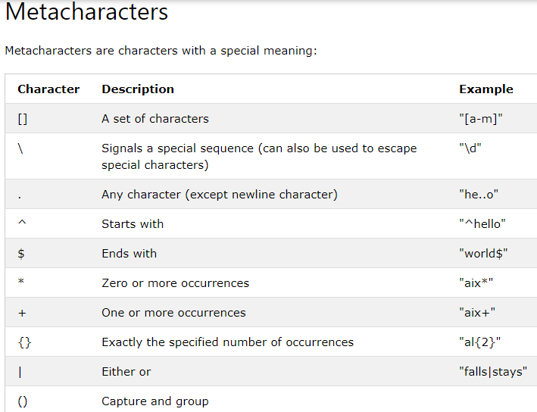
Try : https://www.w3schools.com/python/gloss_python_regex_metacharacters.asp

Slide 189
15. Misscelaneous

Slide 190
Miscellaneous
What are python namespaces?
A Python namespace ensures that object names in a program are unique and can be used without any conflict. Python implements these namespaces as dictionaries with ‘name as key’ mapped to its respective ‘object as value’.
Let’s explore some examples of namespaces:
Local Namespace consists of local names inside a function. It is temporarily created for a function call and gets cleared once the function returns.
Global Namespace consists of names from various imported modules/packages that are being used in the ongoing project. It is created once the package is imported into the script and survives till the execution of the script.
Built-in Namespace consists of built-in functions of core Python and dedicated built-in names for various types of exceptions.

Slide 191
Miscellaneous
Differentiate between NumPy and SciPy?
NumPy | SciPy
NumPy stands for Numerical Python | SciPy stands for Scientific Python
It is used for efficient and general numeric computations on numerical data saved in arrays. E.g., sorting, indexing, reshaping, and more | This module is a collection of tools in Python used to perform operations such as integration, differentiation, and more
There are some linear algebraic functions available in this module, but they are not full-fledged | Full-fledged algebraic functions are available in SciPy for algebraic computations

Slide 192
Miscellaneous
To display a list of all available modules, use the following command in the Python console:
>>> help('modules')
How is Memory managed in Python?
Memory in Python is managed by Python private heap space. All Python objects and data structures are located in a private heap. This private heap is taken care of by Python Interpreter itself, and a programmer doesn’t have access to this private heap.
Python memory manager takes care of the allocation of Python private heap space.
Memory for Python private heap space is made available by Python’s in-built garbage collector, which recycles and frees up all the unused memory.

